Slide 1
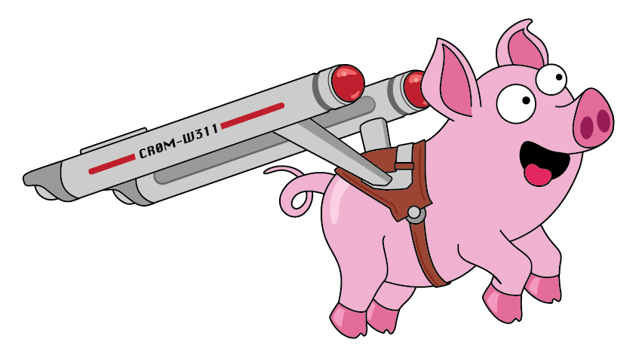
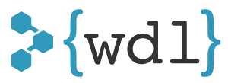
Cromwell & WDL
Bioinformatics workflows at any scale
Jeff Gentry
Data Sciences Platform
Notes:
2 techs bringing sanity to bioinf pipelines/workflows

Slide 2
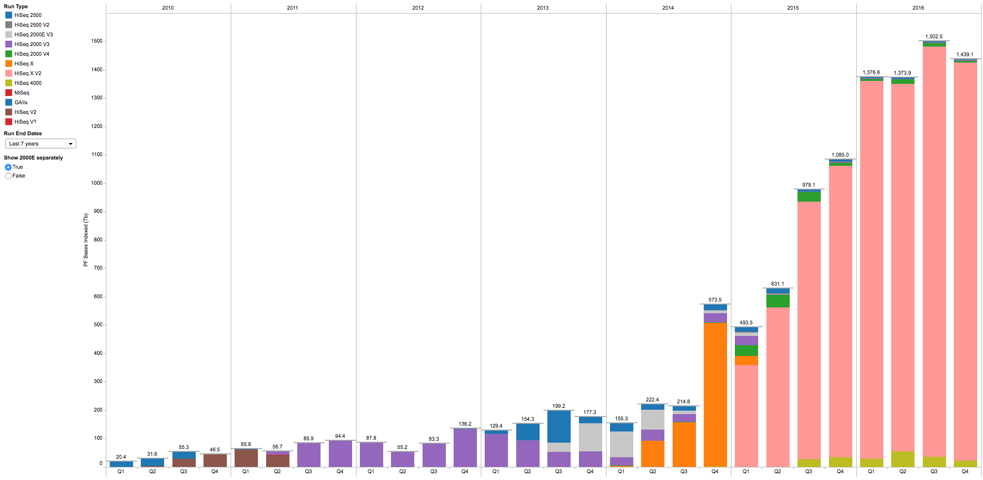
The backdrop: data generation set to explode
Quarterly output (in TBases) of the Genomics Platform
Story begins here
Notes:
GP + CGA + MG
Increase + elasticity == cloud
Let’s do something together
Devils in details, many use cases necessitates flexibility as model

Slide 3
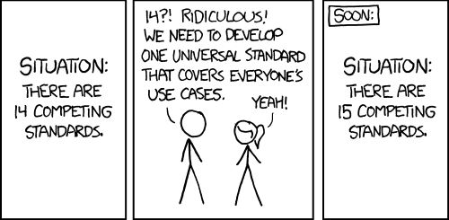
Plenty of workflow solutions to go around
So of course we decided to create a new one.
Randall Munroe, XKCD
https://www.xkcd.com/927/
Notes:
Try to also solve dozen or so other use cases at broad, and there are hundreds out in the world
How many of those can we cover w/ one solution?

Slide 4
Meet WDL + Cromwell
Workflow language that humans can read/write
  Methods developers and biomedical scientists at large
  https://software.broadinstitute.org/wdl/
Execution engine that can
  Run on any platform (on-prem and on Cloud)
  Scale elastically based on workflow needs
  https://github.com/broadinstitute/cromwell
Notes:
Expression of workflows: 2 typical models – embedded dsl vs baroque yaml/json/xml
Embedded powerful, no portability. Markup portable, hard to use directly
Human interop most important thing
WDL SCALES TO A USER’S AMBITIONS
Cromwell scales literally & figuratively. Easy to run small things, easy to run big things.
- Explain Jamie

Slide 5
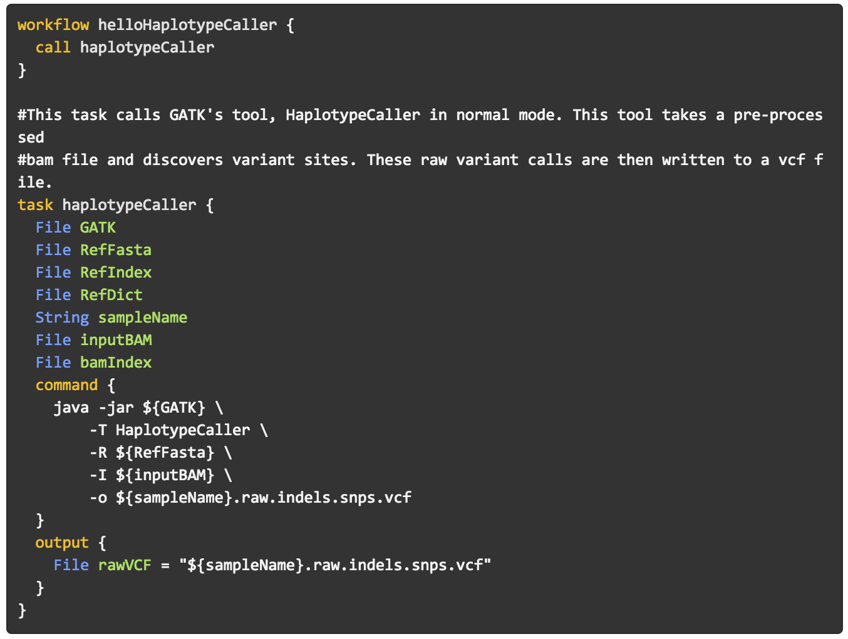
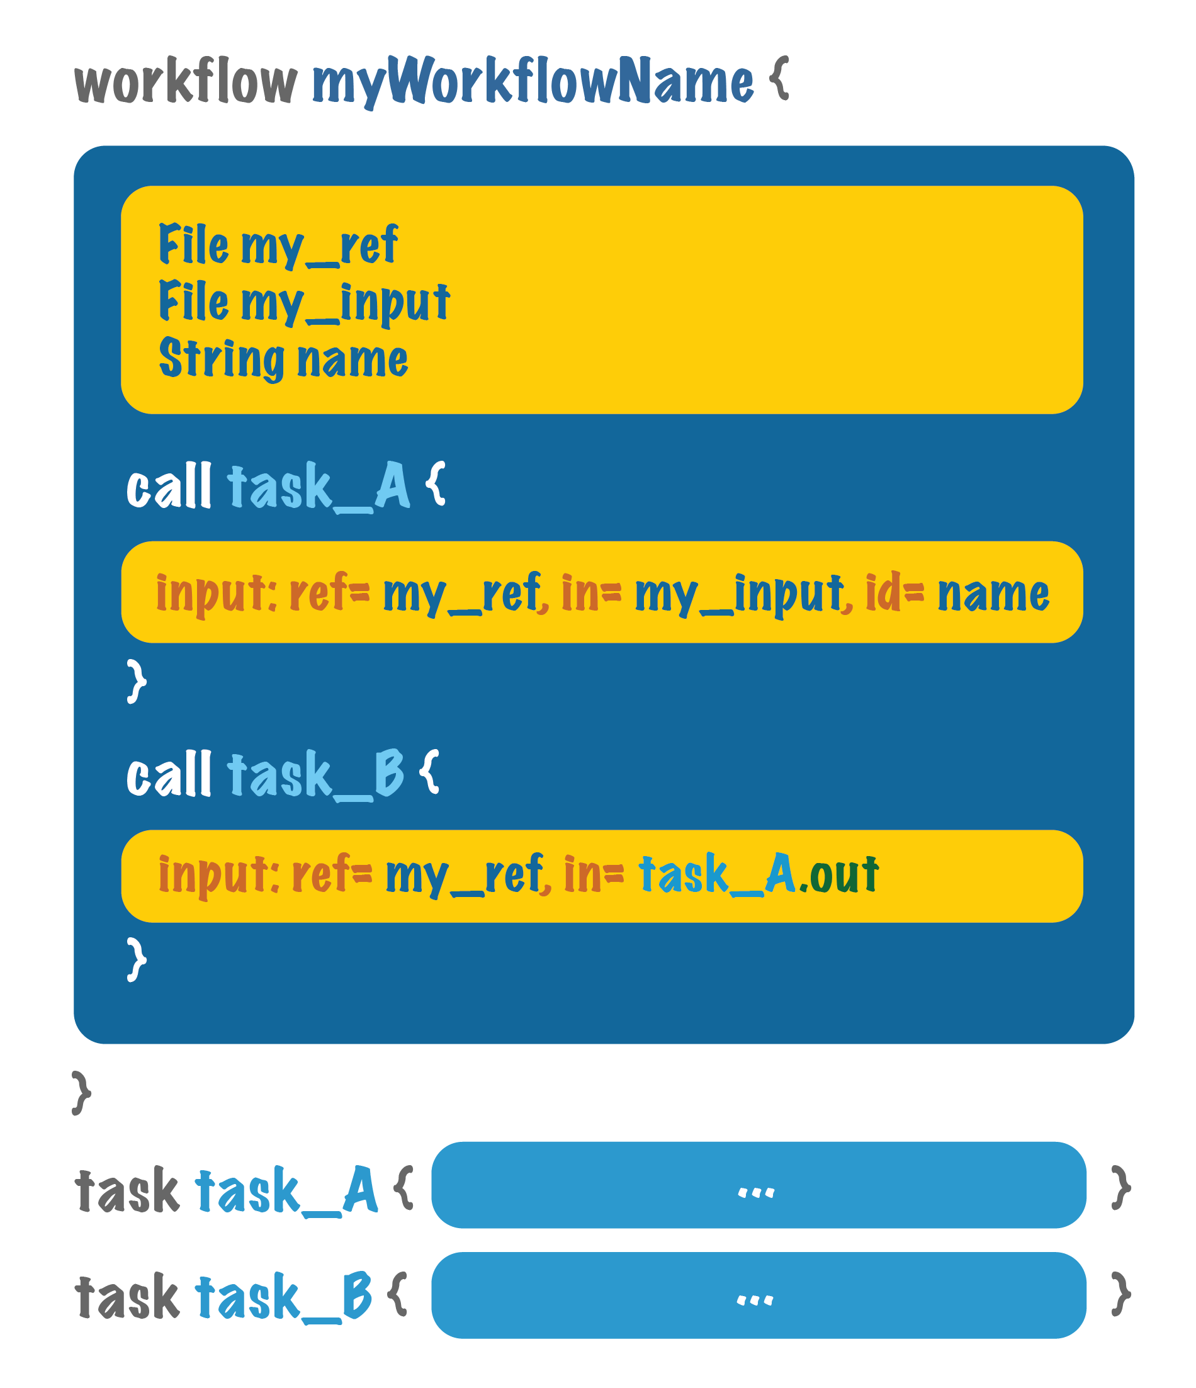
Workflow Description Language
https://software.broadinstitute.org/wdl/

Slide 6
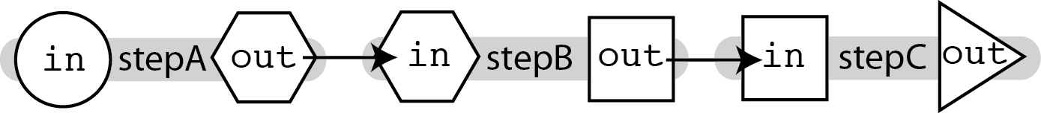
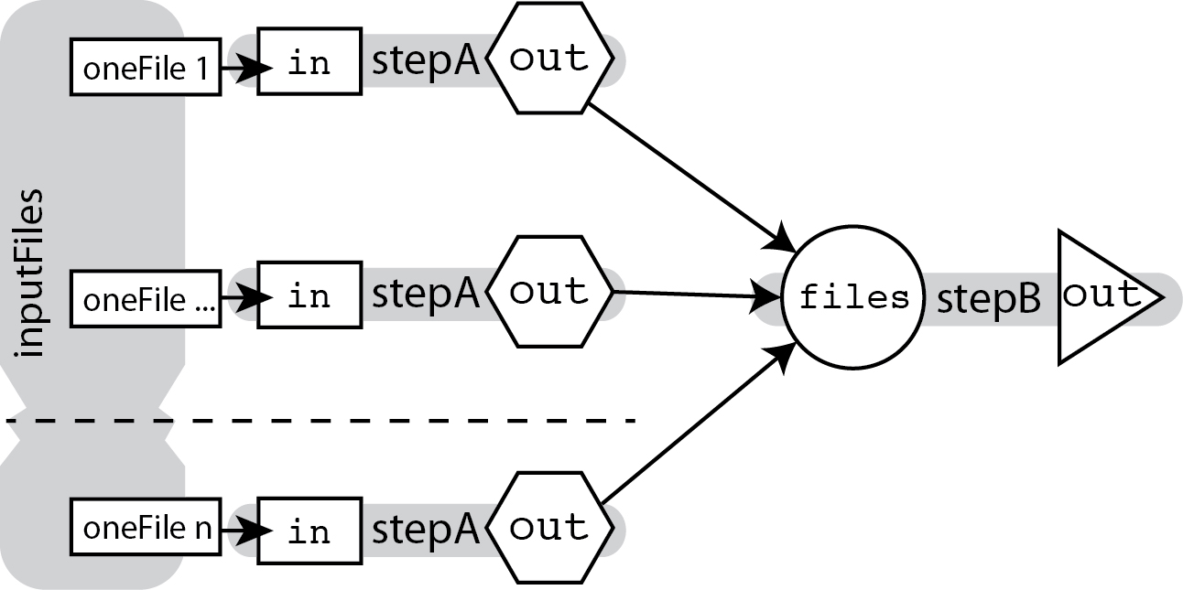
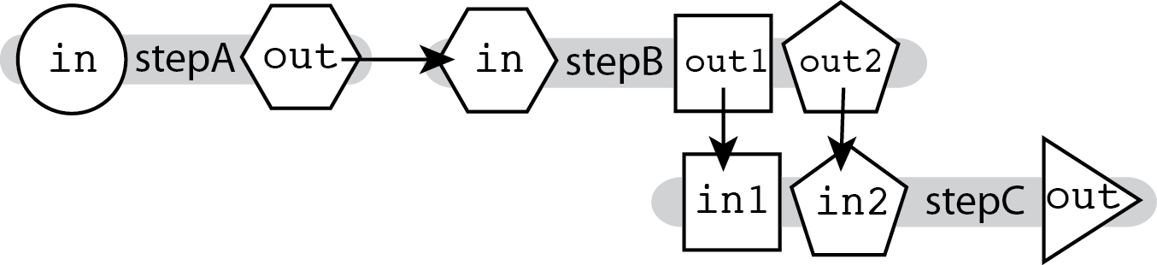
Basic WDL plumbing
Linear CHAINING
Scatter-Gather
call stepA
call stepB { input: in=stepA.out }
call stepC { input: in=stepB.out }
Multi-In/out
Array[File] inputFiles
scatter(oneFile in inputFiles) {
call stepA { input: in=oneFile }
}
call stepB { input: files=stepA.out }
call stepC { input :
in1=stepB.out1, in2=stepB.out2 }

Slide 7
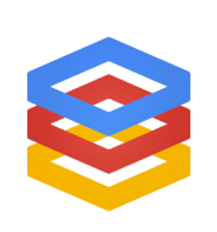

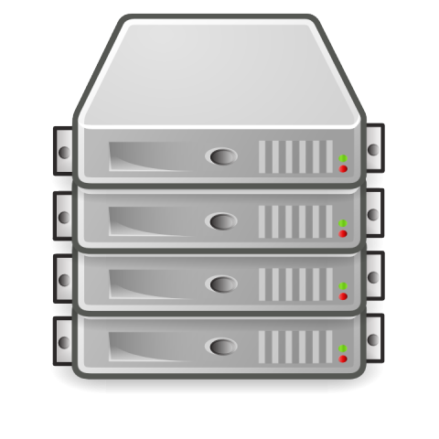
Cromwell execution engine
Multiple backends for
maximum flexibility
Cromwell
Local
HPC
Google
GA4GH
Funnel
…
Coming Soon: AWS, Azure, Alicloud
Notes:
EXPLAIN GA4GH
Plug new clouds & multi-backend workflows

Slide 8

Two main ways to run Cromwell
One-off
Server mode
Simple self-contained command
Appropriate for independent analysts
API endpoints
More scalable
Some devops needs
Appropriate for production
environments
Call-caching!
(aka “ka-ching”)
java -jar cromwell.jar \
run hello.wdl \
hello_inputs.json

Slide 9

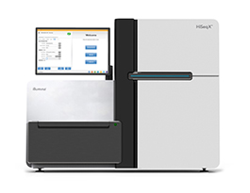

Our production system: Genomes On The Cloud
GS data
buckets
PAPI
Broad on-premises systems
Persistent Cromwell server
ad-hoc GCE cluster
(created on the fly)
NFS
Google Cloud
Zamboni workflow engine
Notes:
- zamboni: not everything ported to cromwell yet

Slide 10
Our development setup: on-prem + on-cloud
GS data
buckets
Direct
CLI
REST API
PAPI
Persistent Cromwell server
ad-hoc GCE cluster
(created on the fly)
Google Cloud
Notes:
Life of tool & algo dev
Demonstrates flexibility of cromwell model, 1 wdl, 3 locations

Slide 11
Example external implementation: Google wdl_runner
Barebones implementation:
Creates GCE VM
Executes wdl_runner.py
  Sets up Cromwell
  Parses WDL workflow
  Submits jobs to PAPI
  Polls for completion
  Copies metadata & outputs to output path
Destroys GCE VM
GS data
bucket
ad-hoc GCE cluster
(created on the fly)
https://cloud.google.com/genomics/v1alpha2/gatk

Slide 12

Example external implementation: wdlRunR
Direct integration with R:
Submit workflows to Cromwell
Use R values as inputs
Monitor jobs for completion
Retrieve data back into R
  Outputs
  Logs
  Job metadata
https://github.com/seandavi/wdlRunR
Notes:
Powerful marriage of interactive & batch analysis

Slide 13
The rest of the team
Dan Billings
Miguel Covarrubias
Thibault Jeandet
Chris Llanwarne
Ruchi Munshi
Khalid Shakir
Kate Voss
Notes:
The folks who make it all possible

Slide 14
Thanks!
My Email:
jgentry@broadinstitute.org
User Forum:
https://gatkforums.broadinstitute.org/wdl/categories/ask-the-wdl-team
More Information:
https://software.broadinstitute.org/wdl
https://www.github.com/broadinstitute/wdl
https://www.github.com/broadinstitute/cromwell

