Slide 1
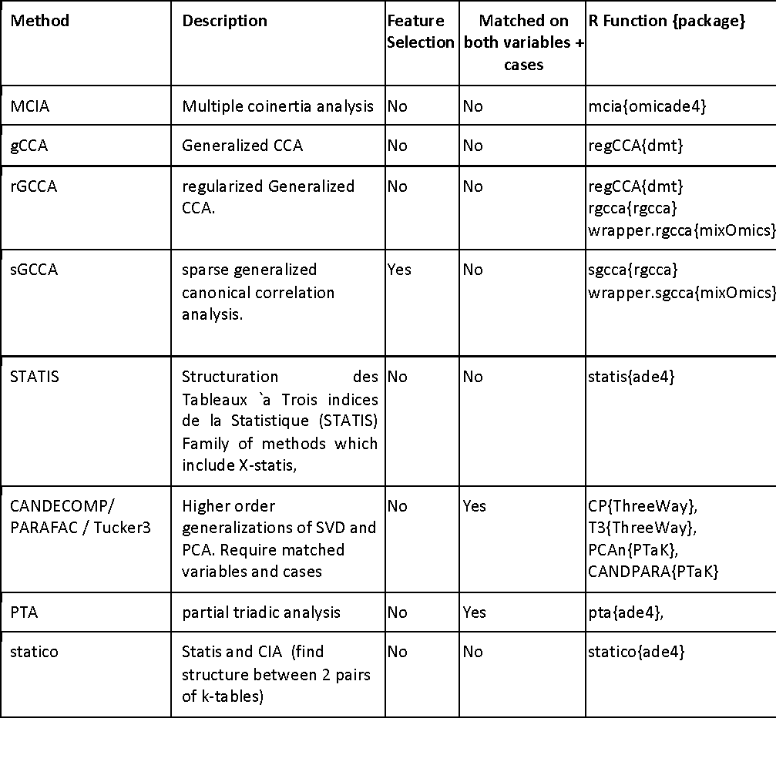
Dimension reduction methods for multiple >2 datasets
(aka tensor decomposition)
Meng C, Zeleznik OA, Thallinger GG,, Amin Gholami A, Kuster B, Culhane AC. Dimension reduction techniques for the integrative analysis of multi-omics data Brief Bioinform (2016) 17 (4): 628-641
Bioc2017 aedin@jimmy.harvard.edu @AedinCulhane

Slide 2
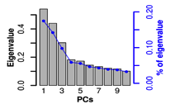
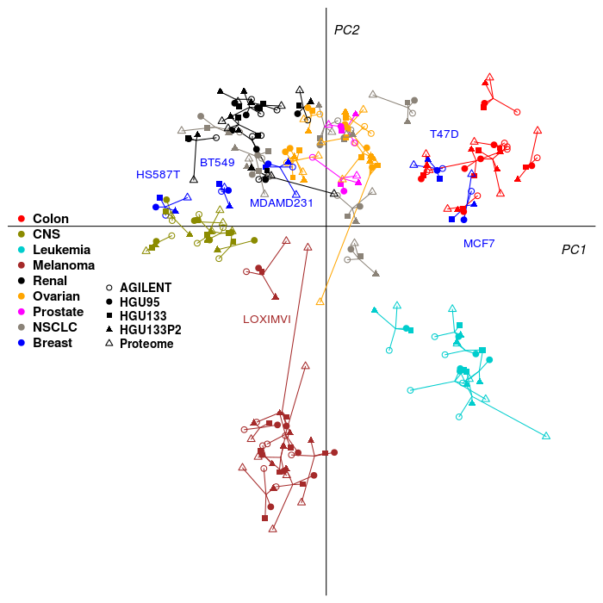
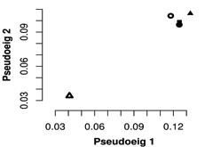
MCIA of 5 data sets (NCI60)
B
A
C
Bioc2017 aedin@jimmy.harvard.edu @AedinCulhane

Slide 3
mogsa (Bioconductor package)
moa() performs multiple factor analysis or STATIS mbpca() performs either consensus PCA, generalized CCA and multiple co-inertia analysis
    method= “globalScore” : consensus PCA
    method= “blockScore” : generalized canonical correlation analysis
    method= “blockLoading” : multiple co-inertia analysis
se.cPCA<-mbpca(lapply(se, exprs), ncomp=10, method="globalScore") # cPCA
Meng C, Kuster B, Culhane AC* and Gholami AM* (2014) A multivariate approach to the integration of multi-omics datasets. BMC bioinformatics 15(1), 162
Bioc2017 aedin@jimmy.harvard.edu @AedinCulhane

Slide 4
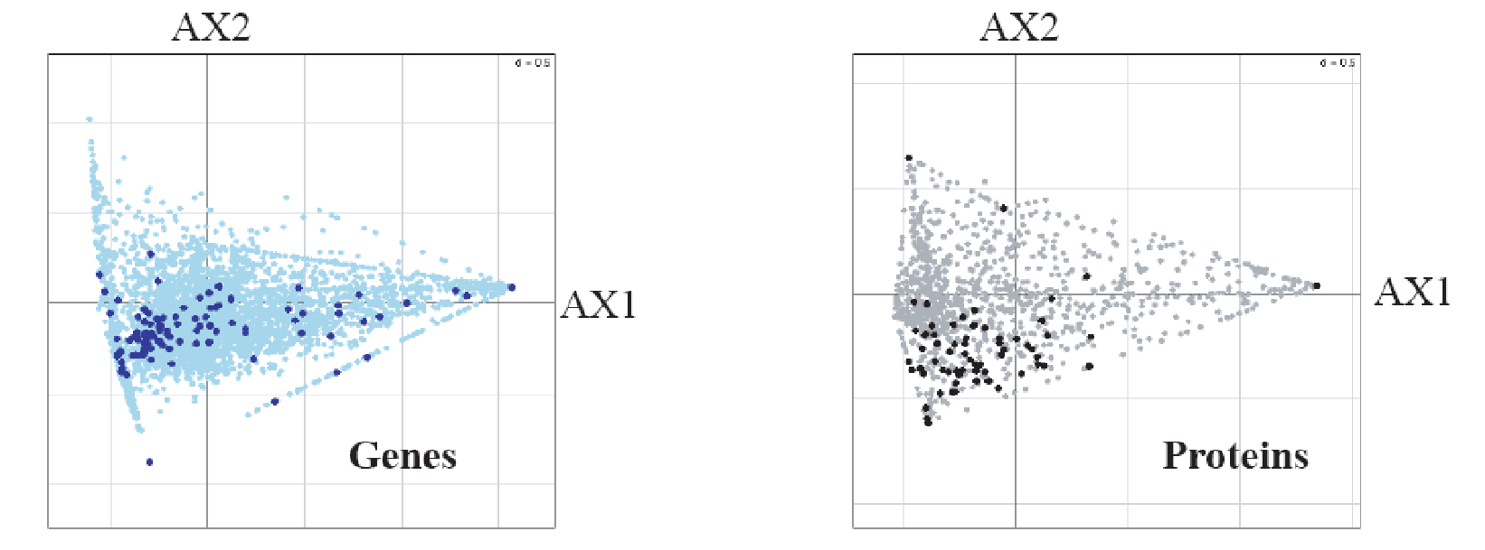
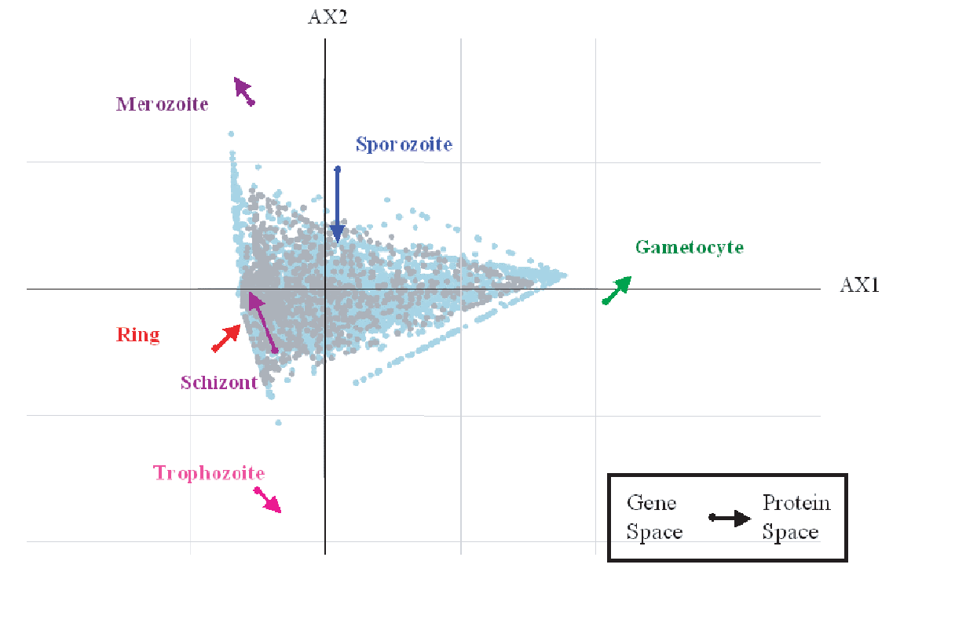
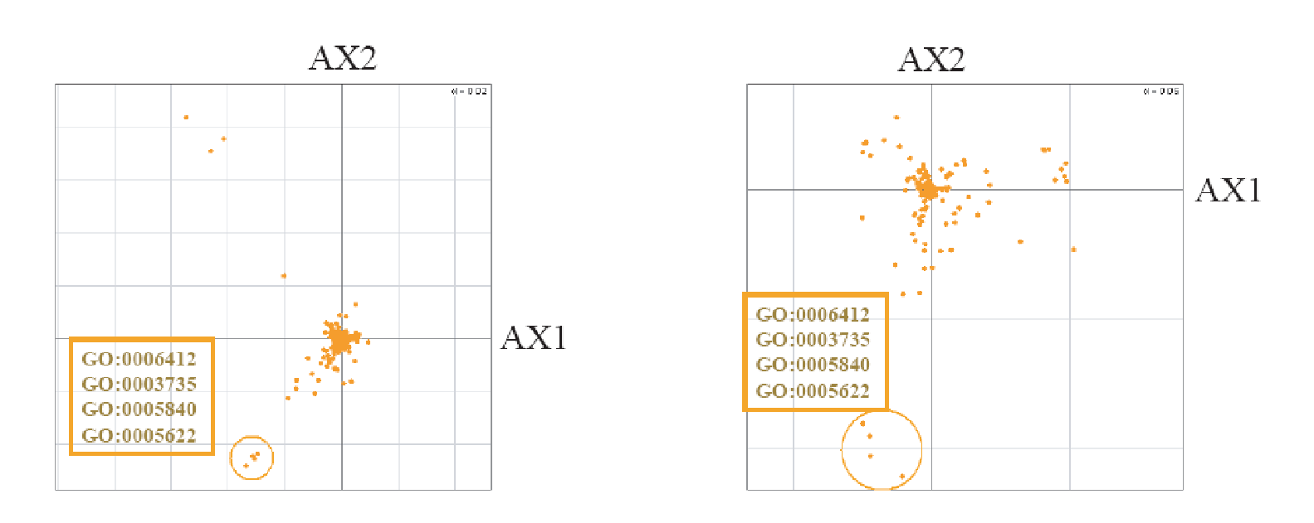
Projection of GO terms
Variables
Sample with variables
GO Terms
Fagan A, Culhane AC, Higgins DG. (2007) A Multivariate Analysis approach to the Integration of Proteomic and Gene Expression Data. Proteomics. 7(13):2162-71.
Bioc2017 aedin@jimmy.harvard.edu @AedinCulhane

Slide 5
MOGSA
Multiple omics data
Binary gene set annotation matrices
Output
observation
gene sets
observation
gene
gene
Gene set
Input
Gene space
axis
axis
feature
Matrix multiplication
gene set
Multivariate analysis
Matrix multiplication
axis
Step 2
Gene set space
observation
Step 1
Observation space/
Latent variables
Step 3
Meng C, Kuster B , Peters B, Gholami AM, Culhane AC. moGSA: a multivariate approach for integrative gene-set analysis of multiple omics data. BMC Bioinformatics. In Review.
Bioc2017 aedin@jimmy.harvard.edu @AedinCulhane

Slide 6
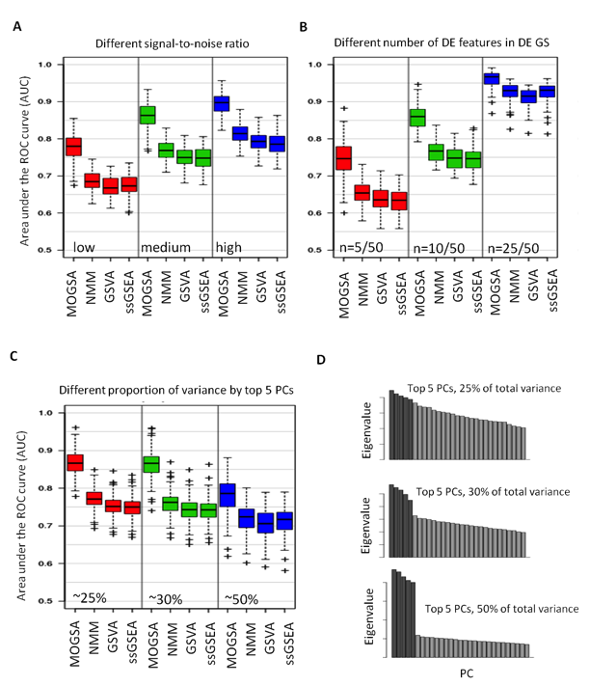
MOGSA outperform other ssGSA approaches when applied to
Synthetic data
Bioc2017 aedin@jimmy.harvard.edu @AedinCulhane

Slide 7
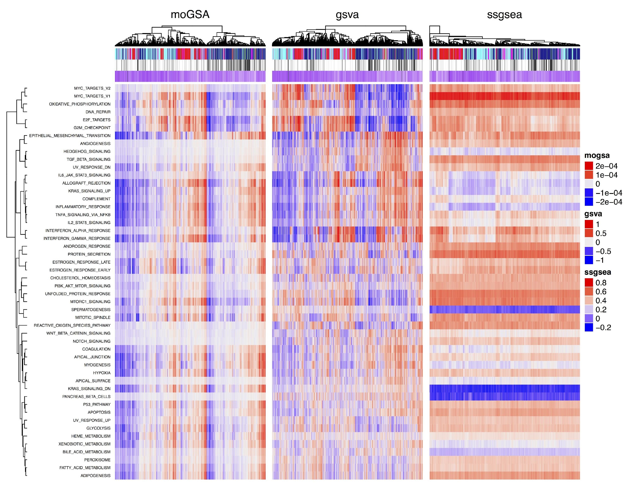
moGSA, GSEA, GSVA of TCGA BRCA
GSVA, ssGSEA: RNAseq
moGSA = RNA+GISTIC
 |  | GSVA | moGSA
 | ssGSEA | 0.014 | 0.001
 | GSVA |  | 0.167
Bioc2017 aedin@jimmy.harvard.edu @AedinCulhane

Slide 8
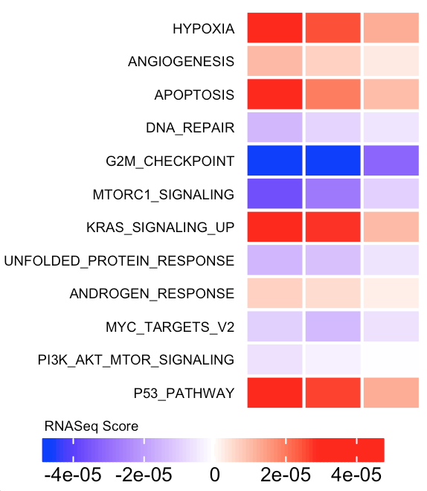
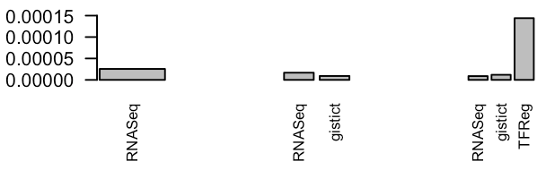
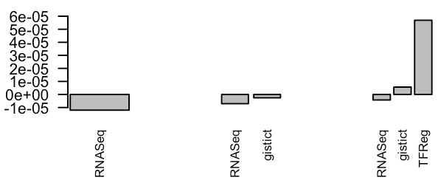
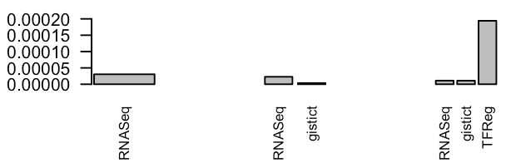
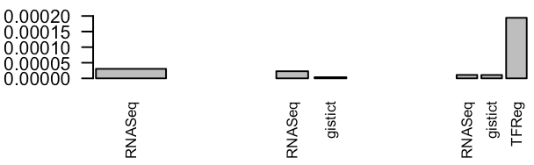
RNA Seq +
Gistict
RNA Seq +
Gistict +
TFReg
RNA Seq
Apoptosis
DNA Repair
Data-wise decomposed gene set score
MTORC1 Signaling
p53 pathway
Bioc2017 aedin@jimmy.harvard.edu @AedinCulhane
Notes:
Figure. Score contribution from a data set (RNASeq) changes dynamically as more platforms are added in the moGSA analysis. All datasets included 995 BRCA patients 50 hallmark genesets. The plots show the RNASeq score component (left) and data wise decomposed scores (right) in select MSigDB Hallmark pathways for patient ID: TCGA-BH-A0BQ-01.
Note that the first moGSA analysis included RNASeq dataset twice, because moGSA requires 2 or more data sets.
The TFReg dataset refers to the Regulatory impact of 117 Transcription Factors (TF) on tumor specific gene expression patterns calculated by the RABIT tool

Slide 9
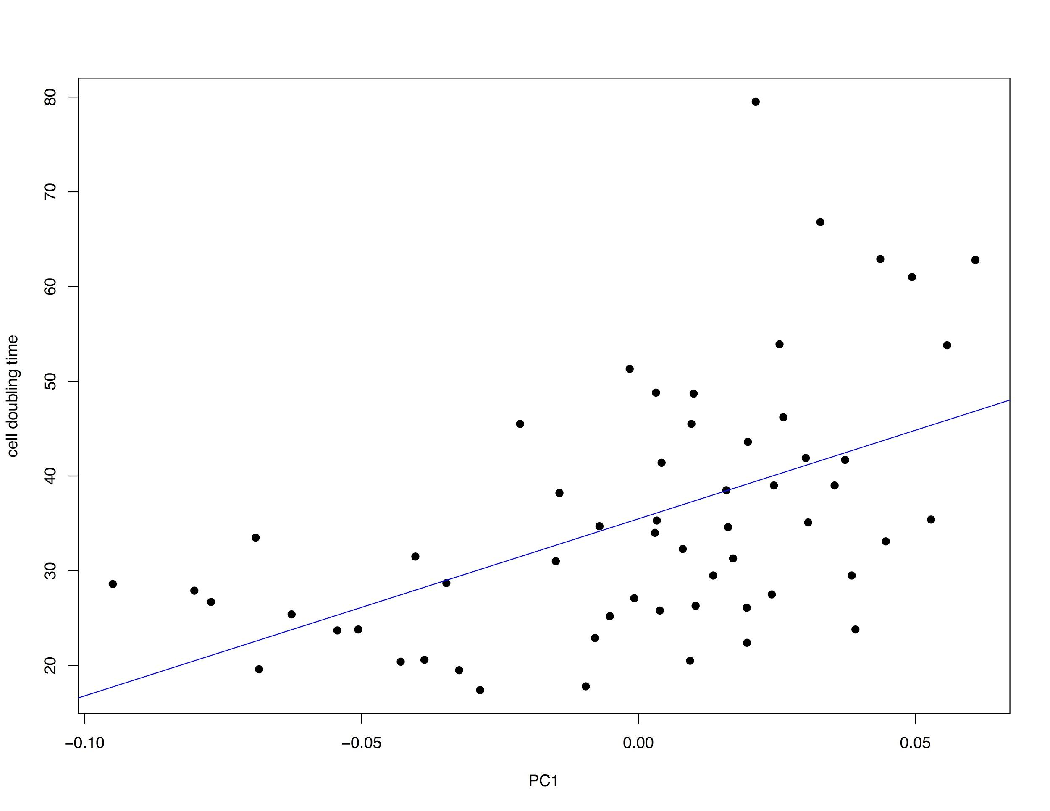
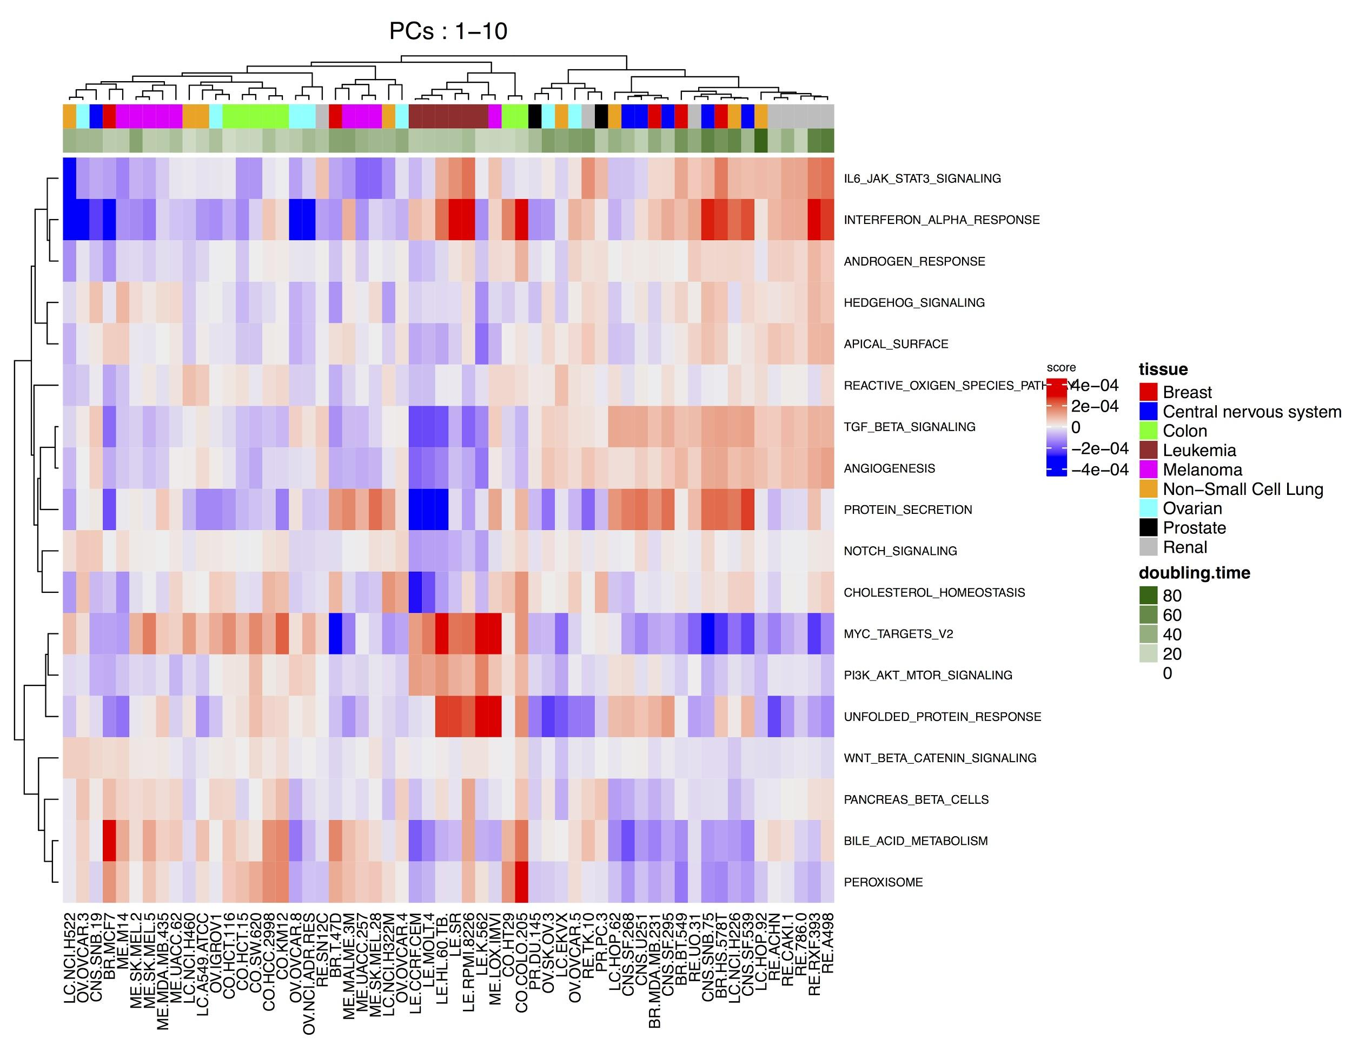
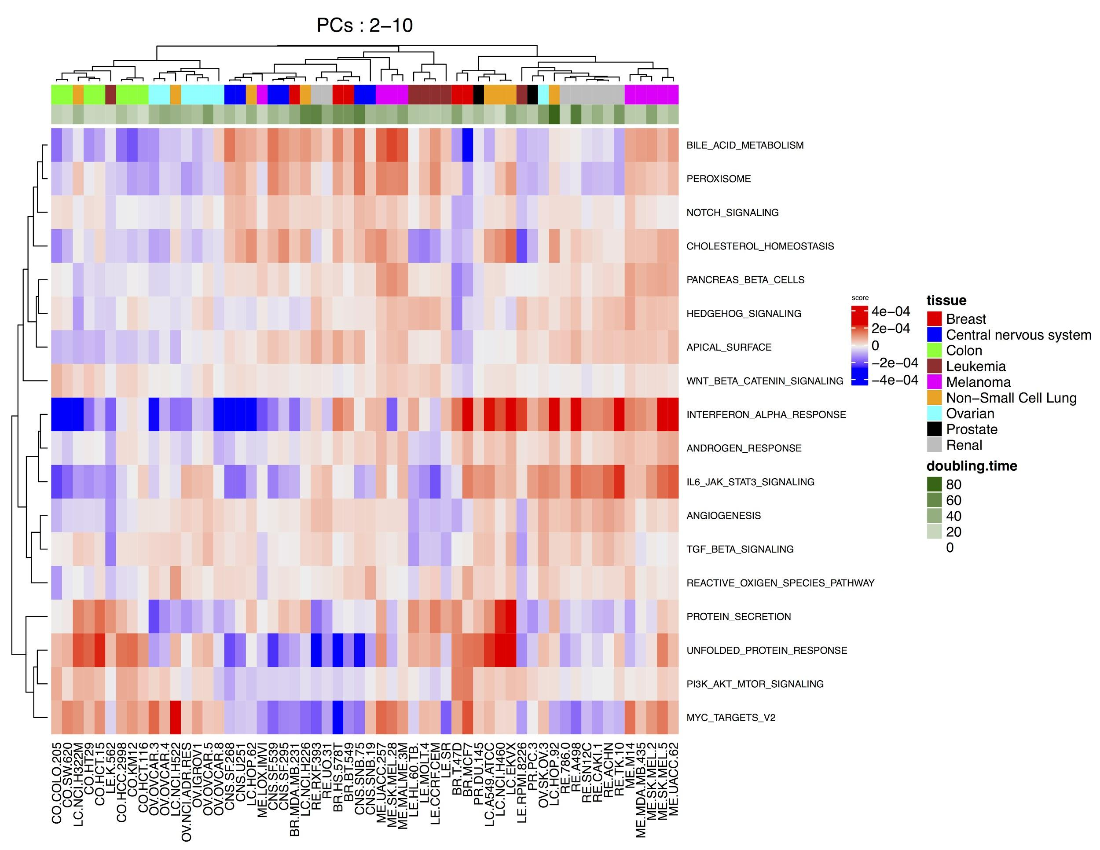
Remove a component
58 NCI60 samples and 18 Hallmark Genesets
4 datasets - hgu195, hgu133, hgu133p2, agilent
Bioc2017 aedin@jimmy.harvard.edu @AedinCulhane

Slide 10
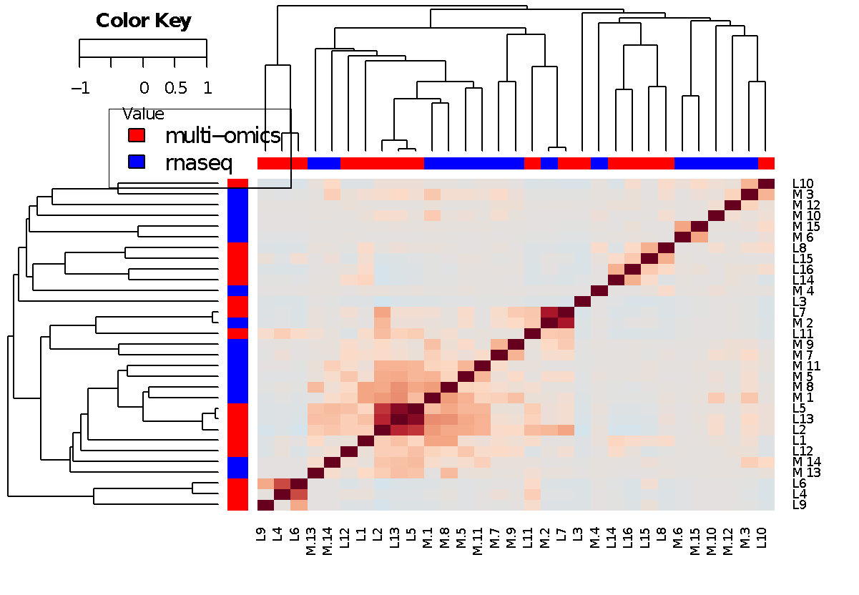
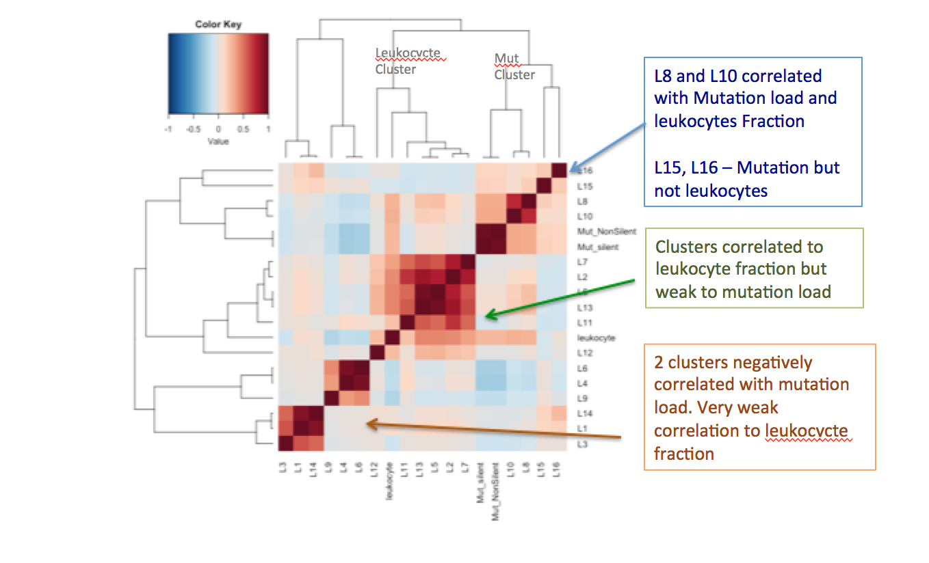
moGSA applied to TCGA panImmune Cluster discovery
Bioc2017 aedin@jimmy.harvard.edu @AedinCulhane

Slide 11
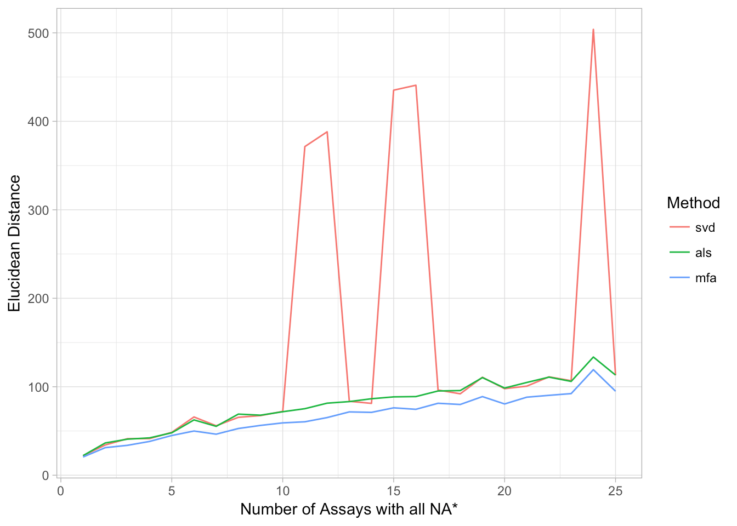
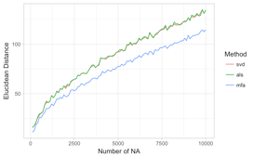
Using MFA to impute NA
Missing (at random)
B) Missing row/cols
MFA (blue), low rank SVD (red), fast alternatively least square (ALS, green)

