Slide 1
Dockers and AMI
Bioconductor User Resources

Slide 2
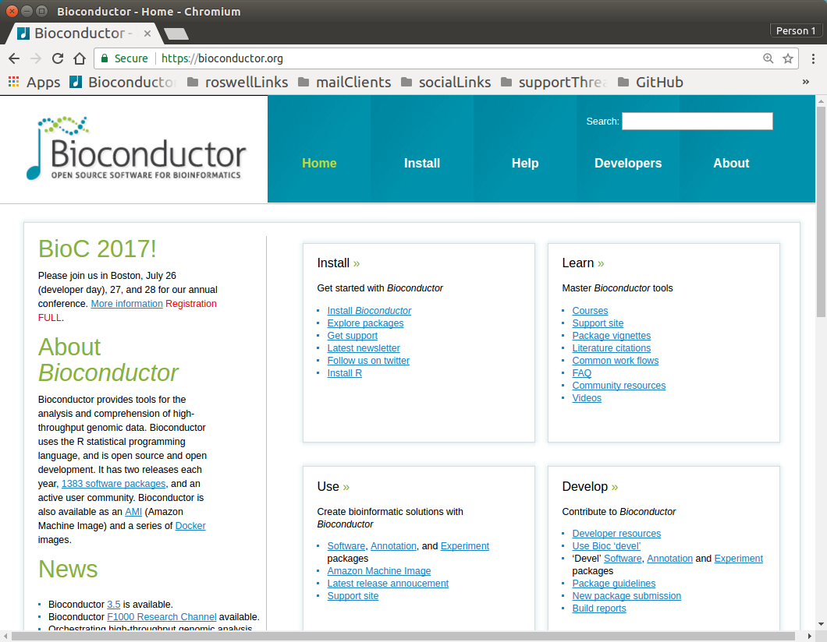

Slide 3
Dockers
https://bioconductor.org/help/docker/
https://hub.docker.com/r/bioconductor/

Slide 4
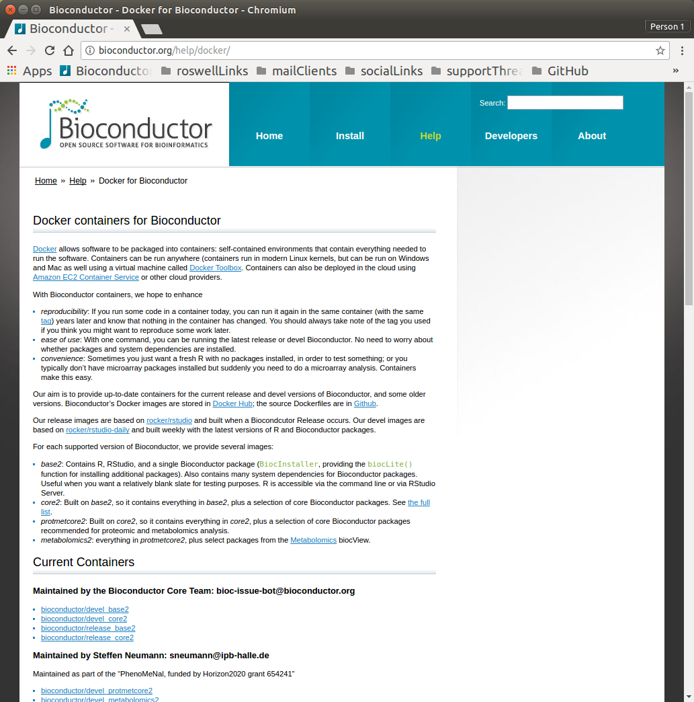

Slide 5
Maintained by the Bioconductor Core Team: bioc-issue-bot@bioconductor.org
Maintained by Steffen Neumann: sneumann@ipb-halle.de
Maintained as part of the “PhenoMeNal, funded by Horizon2020 grant 654241”
Maintained by Laurent Gatto: lg390@cam.ac.uk
bioconductor/devel_base2
bioconductor/devel_core2
bioconductor/release_base2
bioconductor/release_core2
bioconductor/devel_protmetcore2
bioconductor/devel_metabolomics2
bioconductor/release_protmetcore2
bioconductor/release_metabolomics2
bioconductor/devel_mscore2
bioconductor/devel_protcore2
bioconductor/devel_proteomics2
bioconductor/release_mscore2
bioconductor/release_protcore2
bioconductor/release_proteomics2

Slide 7
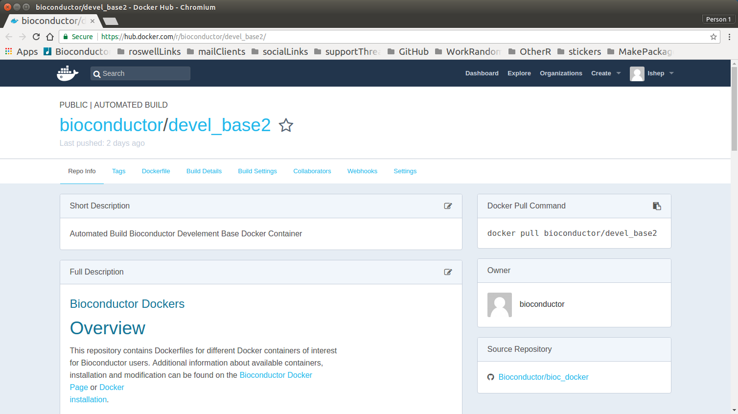

Slide 8
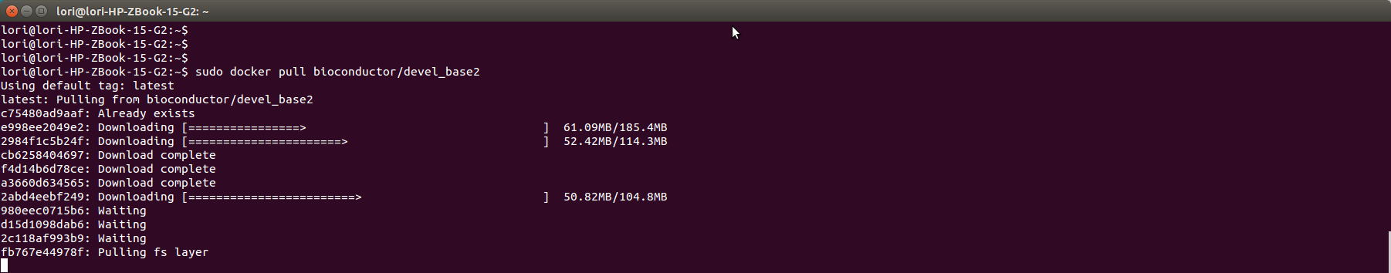
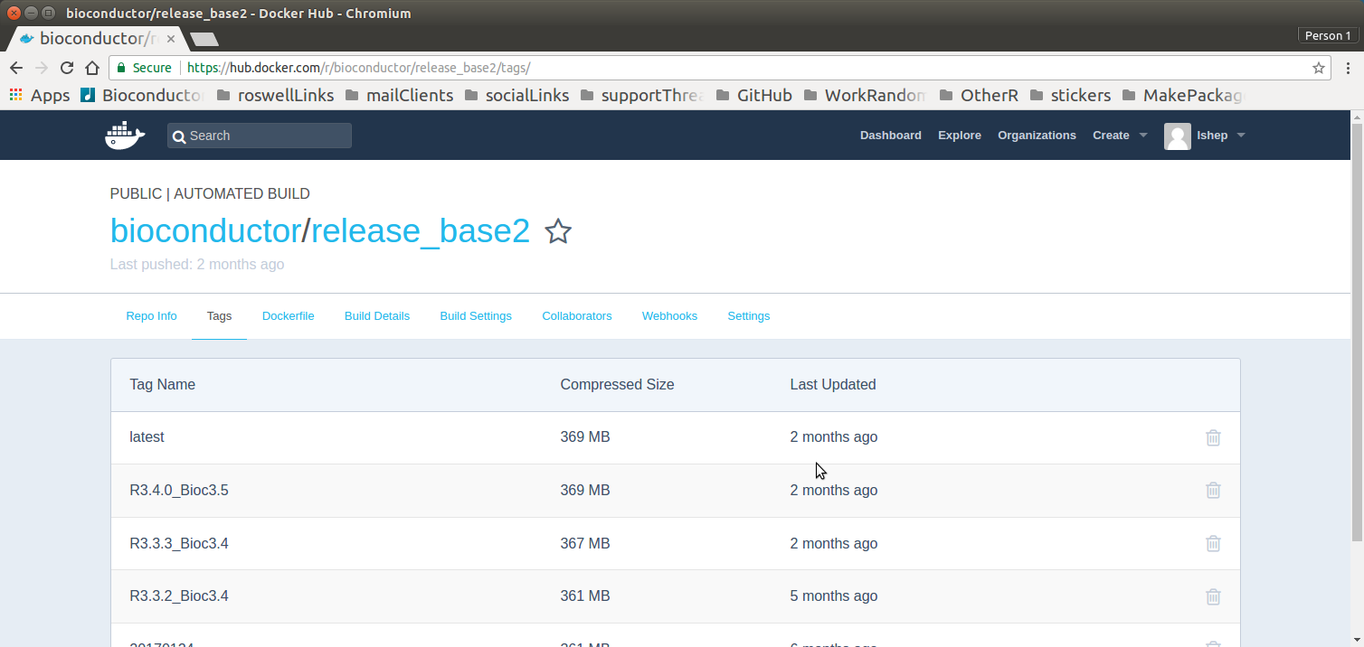
Example:
docker pull bioconductor/release_base2:R3.3.3_Bioc3.4

Slide 9
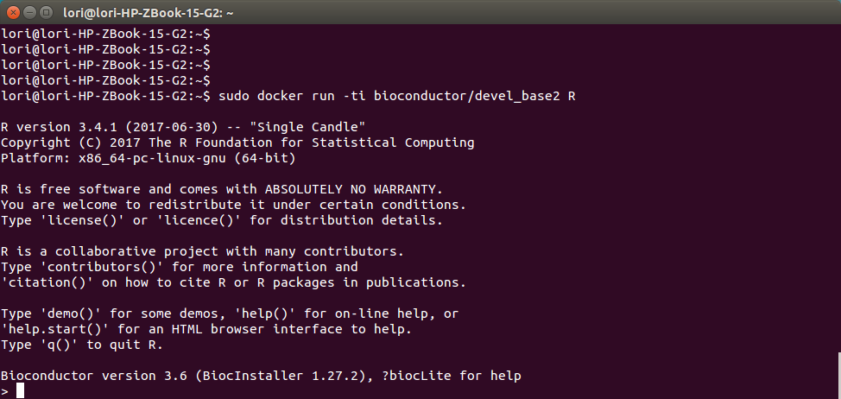

Slide 10
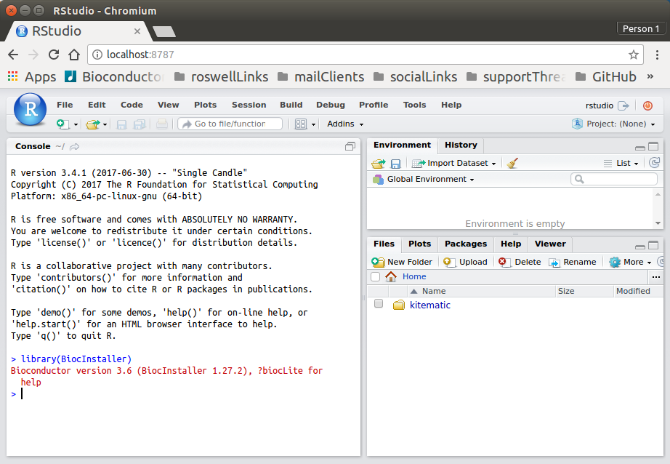
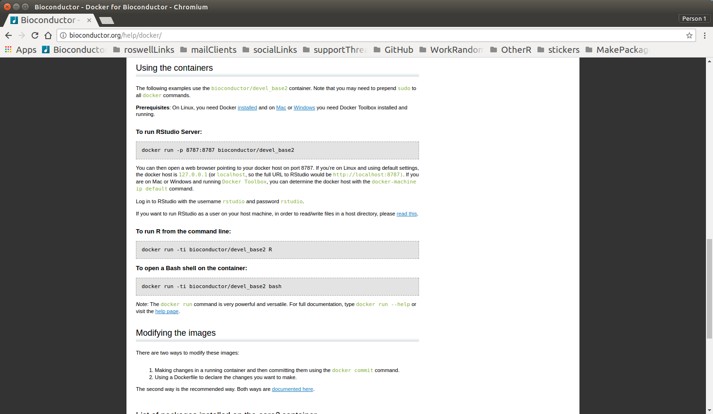
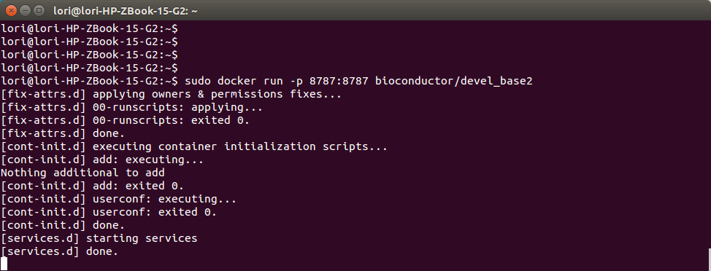
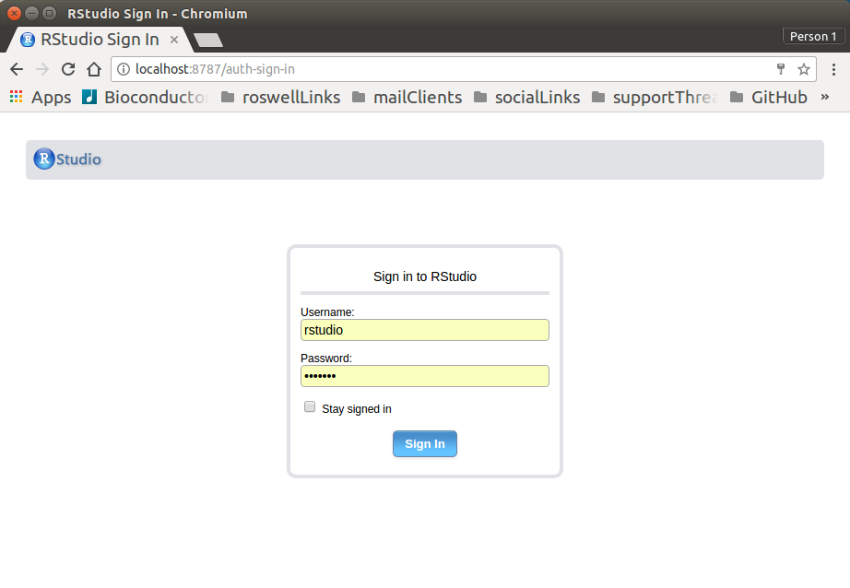

Slide 11
AMI
https://bioconductor.org/help/bioconductor-cloud-ami/
https://aws.amazon.com/console/

Slide 13
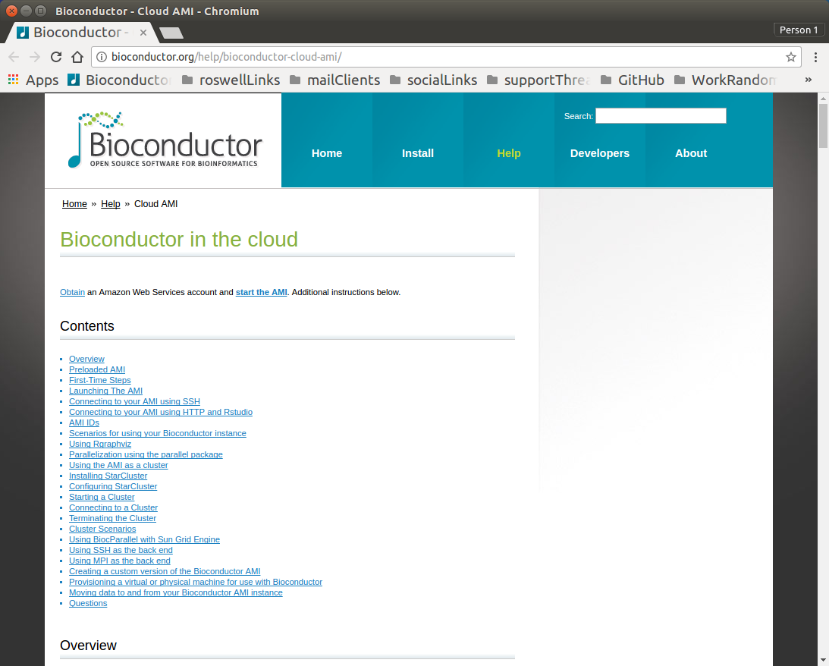

Slide 14
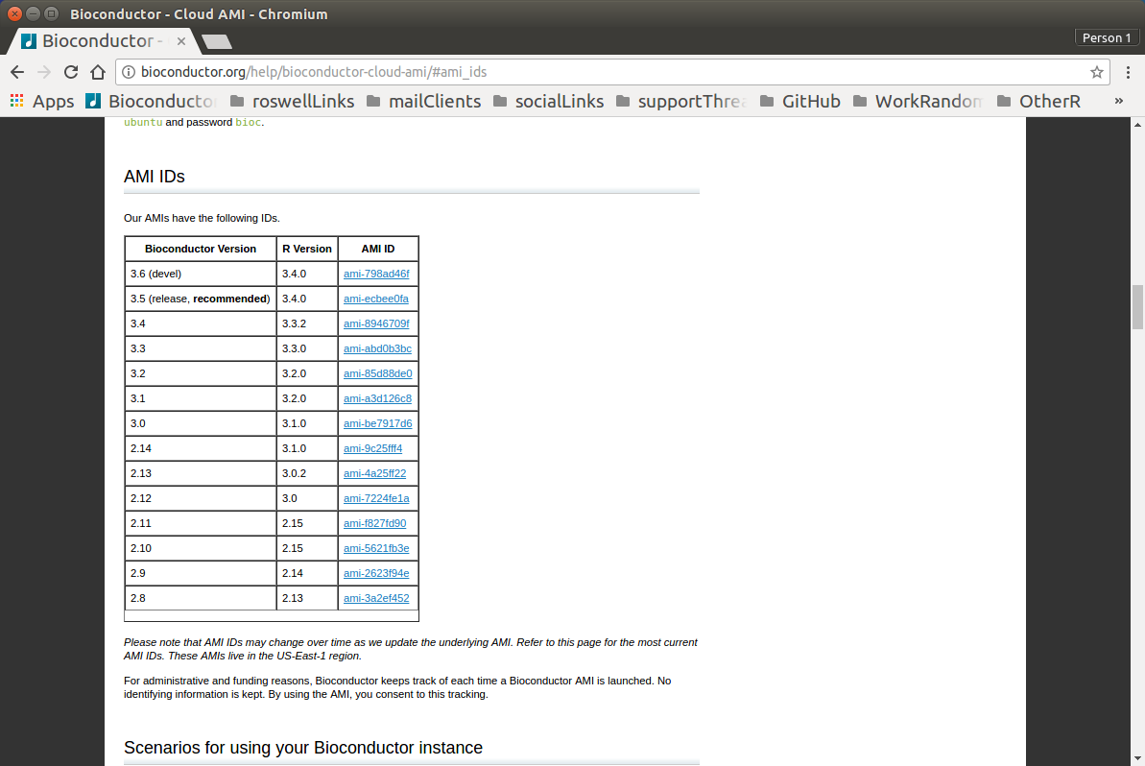

Slide 15
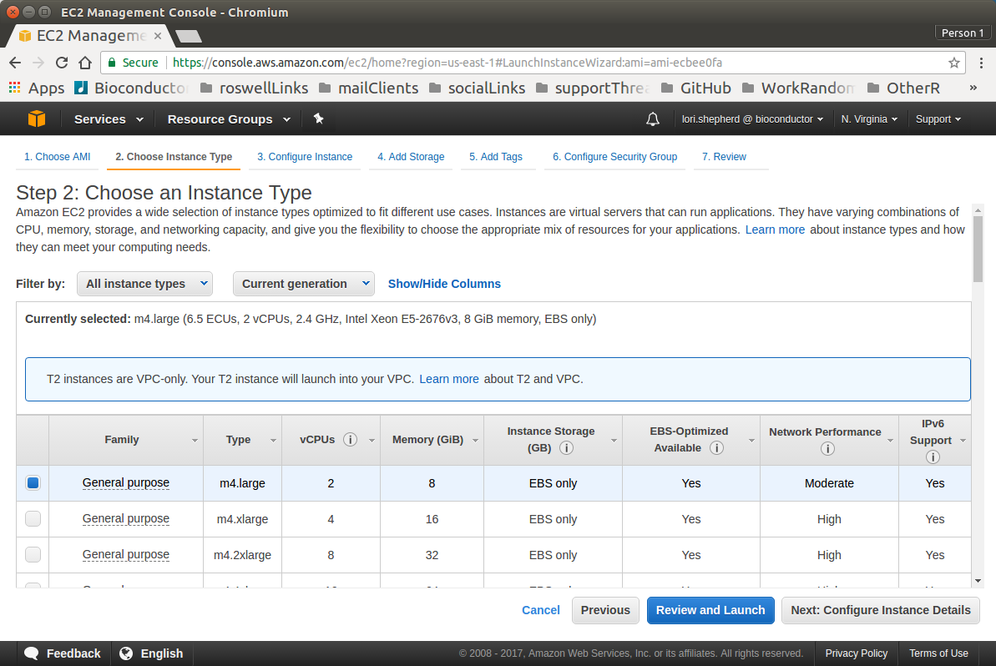

Slide 16
Lori Shepherd
lori.shepherd@roswellpark.org

