Slide 1
Analysis of Gene Expression
at the Single-Cell Level
Guo-Cheng Yuan
Department of Biostatistics and Computational Biology
Dana-Farber Cancer Institute
Harvard School of Public Health
Bioconductor, July 31st, 2014

Slide 2
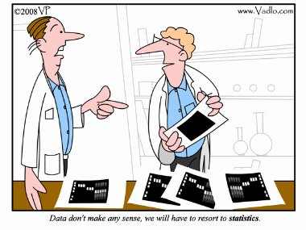
bioconductor

Slide 3


Methods to sequence the DNA and RNA of single cells are poised to transform many areas of biology and medicine.
--- Nature Methods

Slide 4
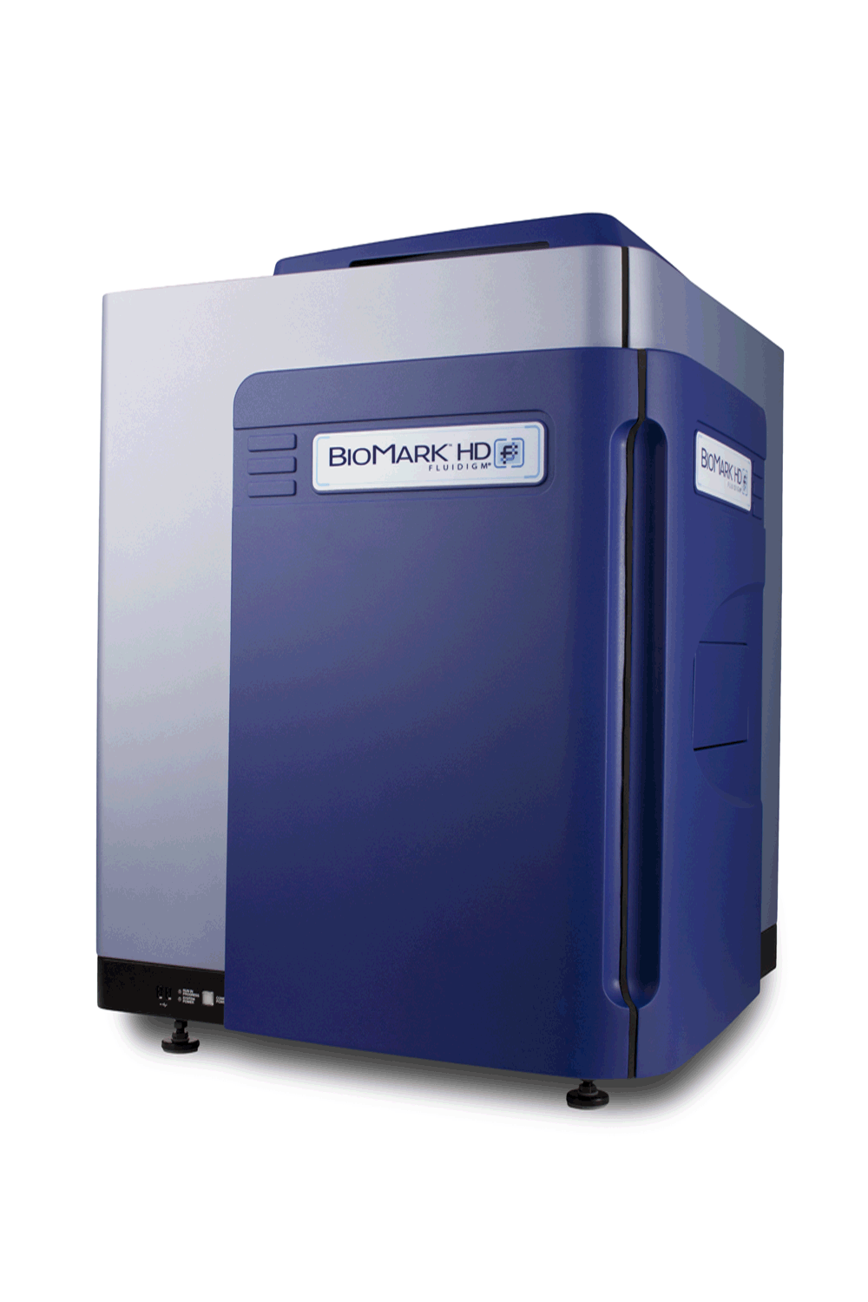
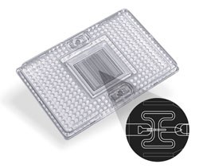



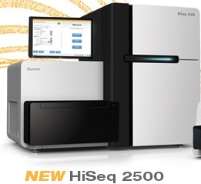
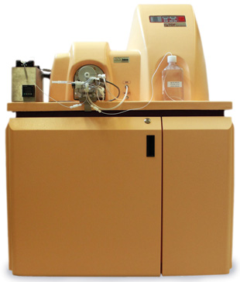

Slide 5
“Recent technical advances have enabled RNA sequencing (RNA-seq) in single cells. Exploratory studies have already led to insights into the dynamics of differentiation, cellular responses to stimulation and the stochastic nature of transcription. We are entering an era of single-cell transcriptomics that holds promise to substantially impact biology and medicine.”
  R. Sandberg, 2014. Nature Methods

Slide 6
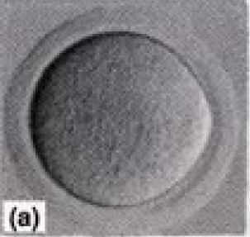
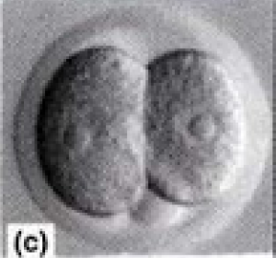
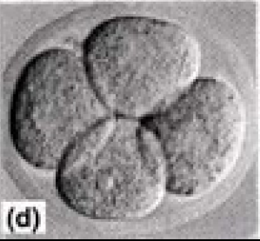


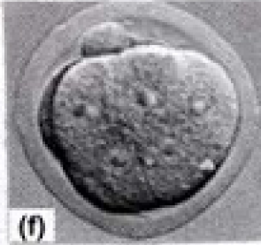

Slide 7
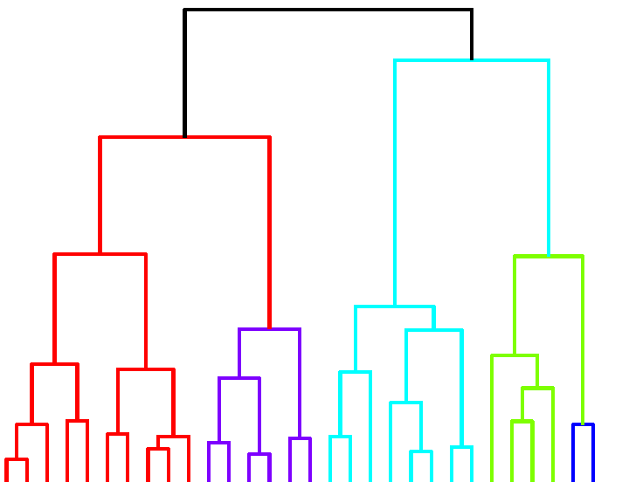
Cell-type A
Cell-type C
Cell Division
Cell-type B
Cell-type E
Cell-type D
Cell-type F

Slide 8
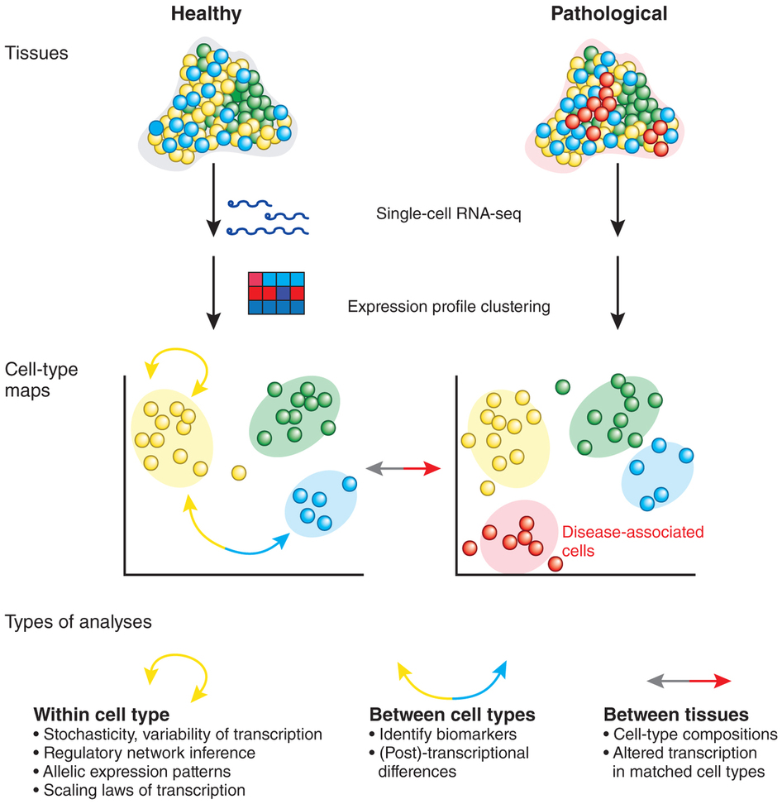
R. Sandberg, 2014. Nature Methods

Slide 9
Challenges in single-cell data analysis
Characterize and distinguish technical/biological variability
Identify new and meaningful cell clusters.
Identify the lineage relationship between different cell clusters.
Characterize the dynamic process during cell-state transitions.
Elucidate the transition of regulatory networks.
Distinguish stochastic vs real variation

Slide 10
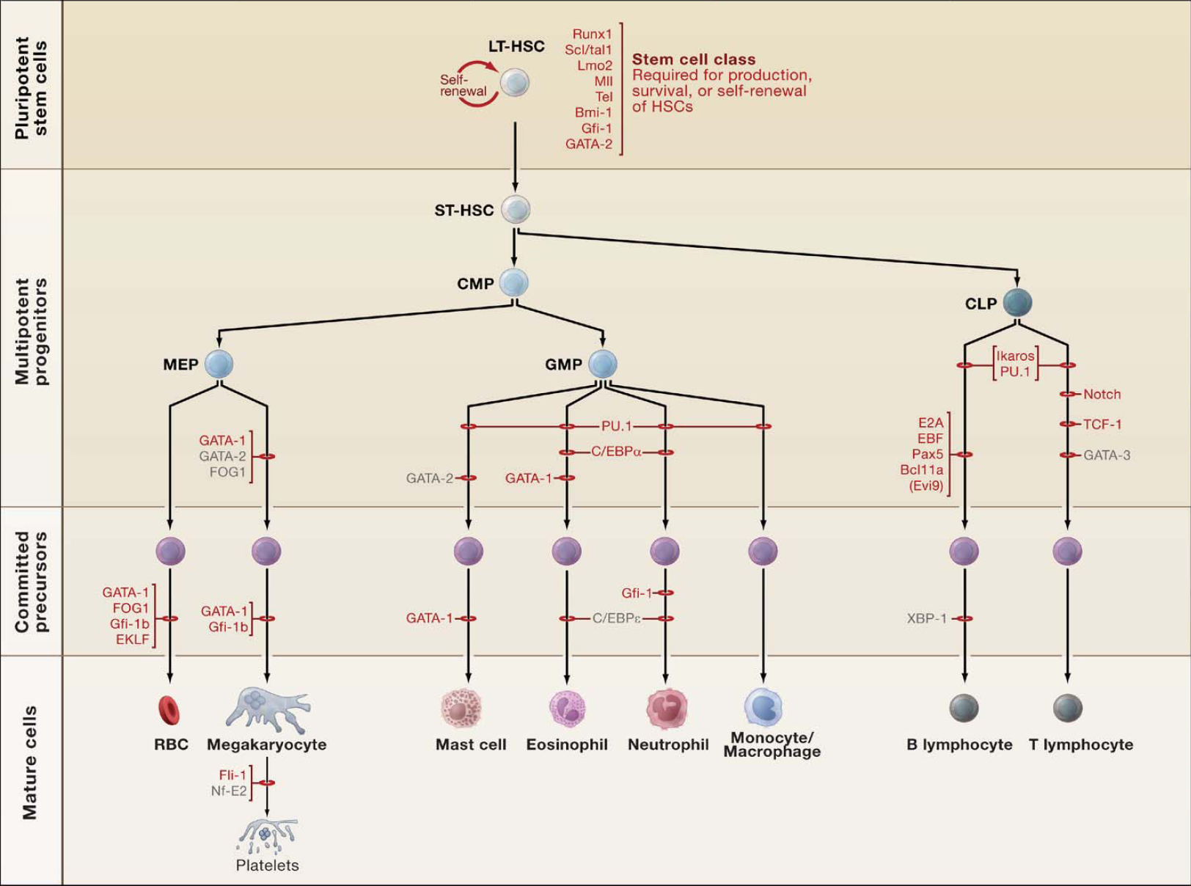
Notes:
Blood system is the paradigm for lineage analysis. Over the years, the overall lineage pattern and lineage-specifying factors have been characterized. Conventional model is that cell-differentiation undergoes a lineage path from LT-HSC to ST-HSC to progenitors to mature differentiated cells. But controversies still exist in this model. CLP vs CMP bifurcation, or common lymphomyeloid progenitors.

Slide 11
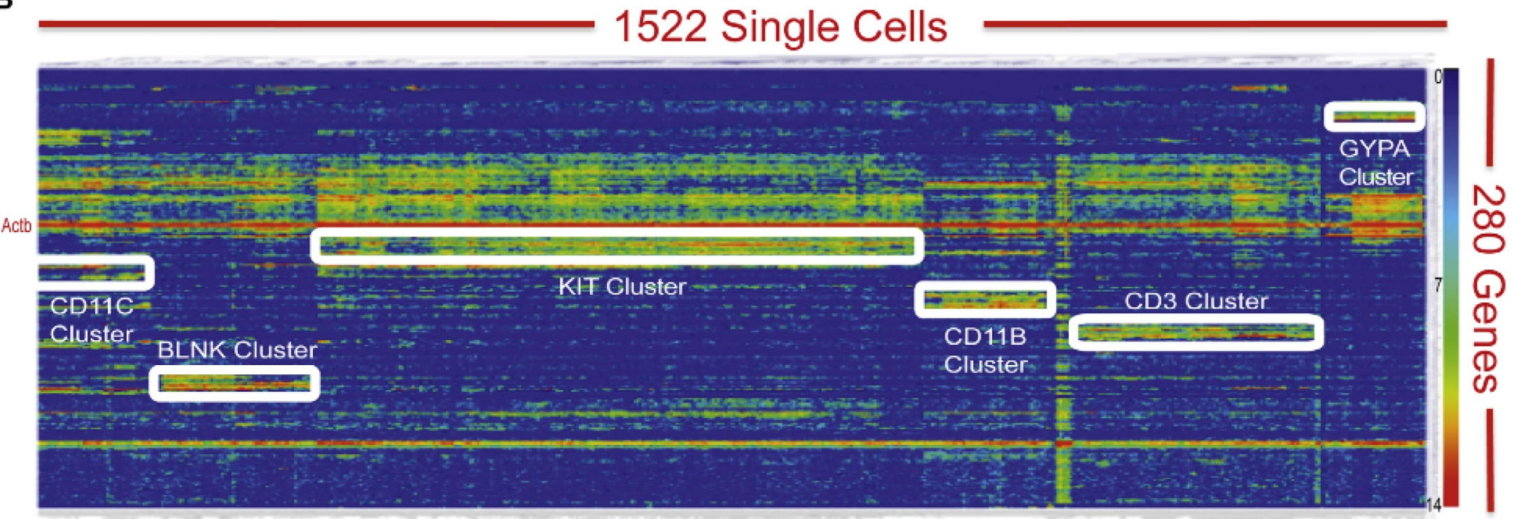
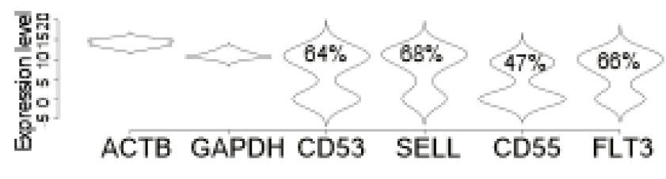
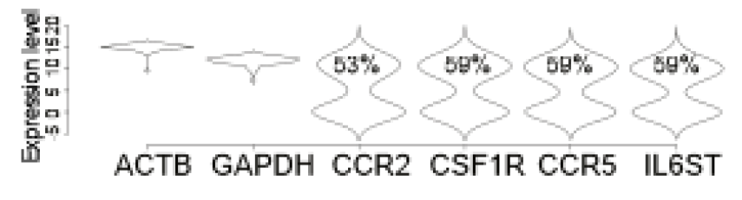
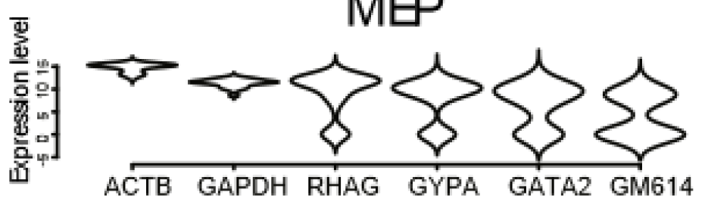
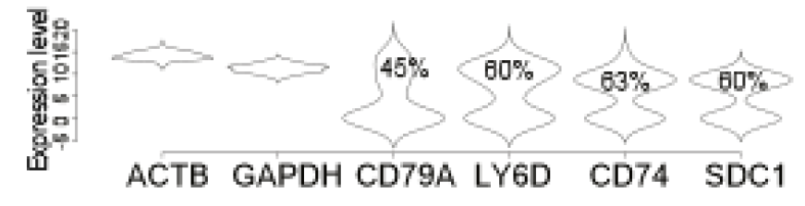
CMP
GMP
MEP
CLP
MEP
Guoji Guo, Eugenio Marco

Slide 12
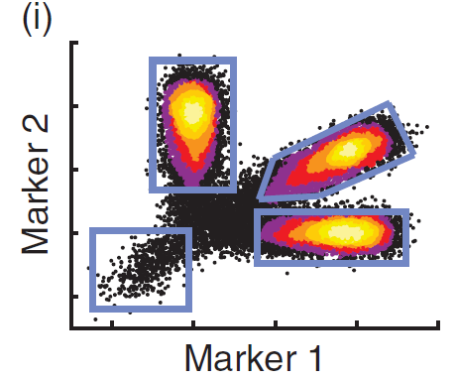
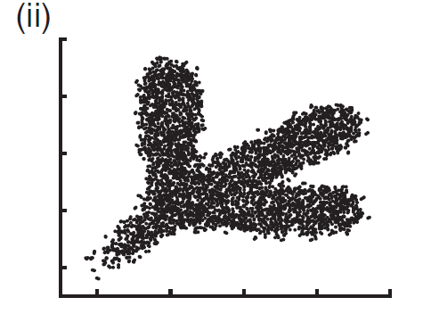
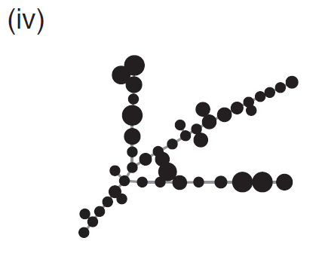
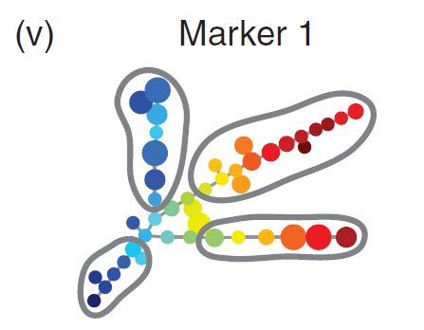
SPADE: a density-normalized, spanning tree model
Down-sample
Clustering,
Spanning-tree
Visualization
Qiu et al. 2011
Nat Biotech, p886

Slide 13
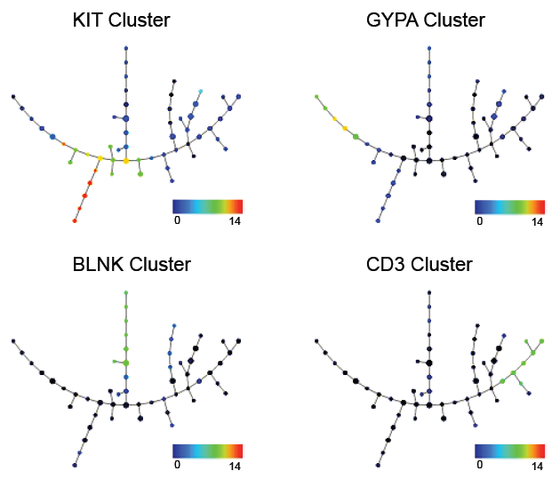

Slide 14
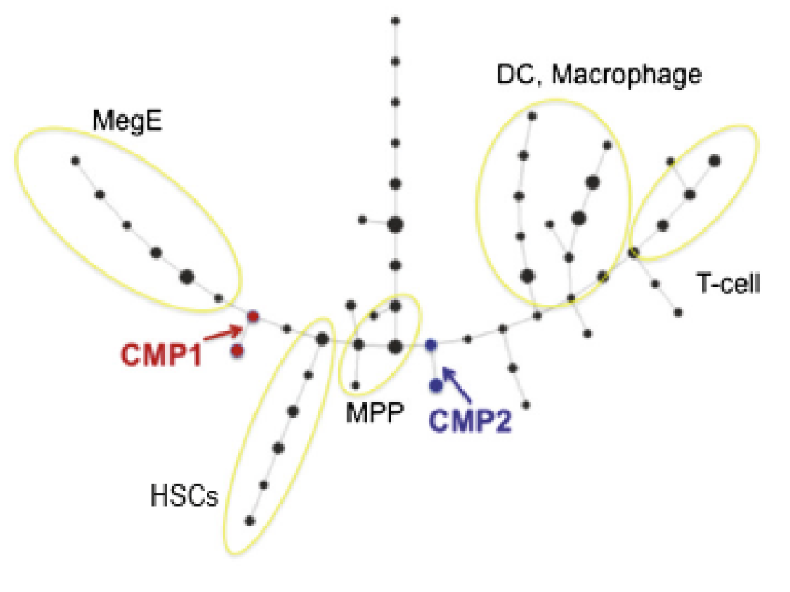

Slide 15
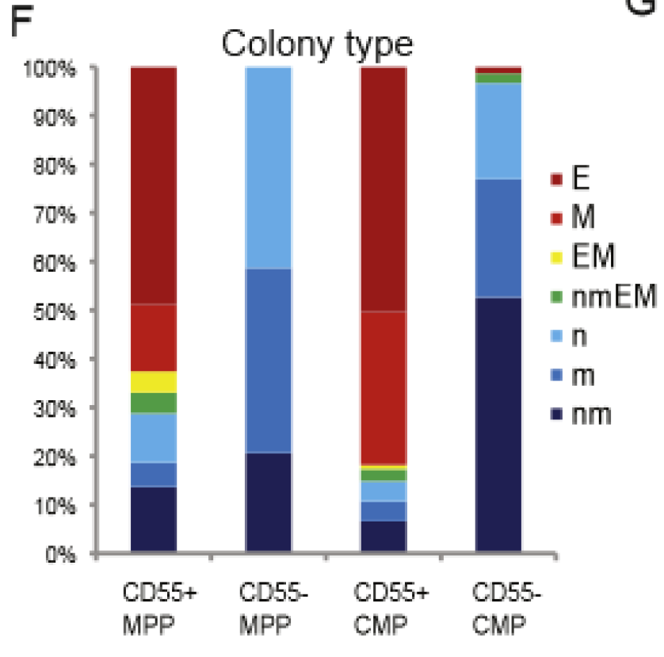
Log2(CMP1/CMP2)
CD55 | 7.87
ICAM4 | 3.98
CD274 | 3.32
MPL | 3.19
TEK | 2.83

Slide 16
Cancer Stem Cells
Each cancer contains a highly heterogeneous cell population.
Clonal evolution contributes to cancer heterogeneity
Cancer cells are hierarchically organized and maintained by cancer stem cells
How are the leukemia stem cells related to normal blood cell lineage? How do they differ?

Slide 17
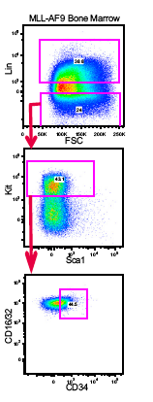
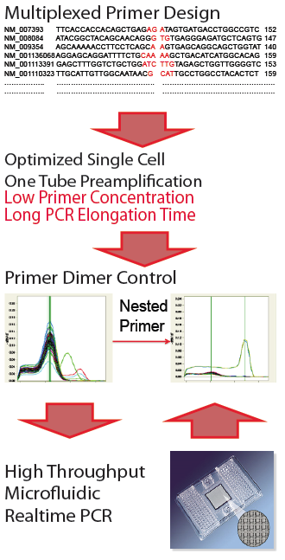
Single cell analysis of the mouse MLL-AF9 acute myeloid leukemia cells
Compilation of mouse cell surface antigens (Lai et al., 1998; eBioscience website)
Primer design for 300 multiplexed PCR (collaboration with Helen Skaletsky)
Micro-fluidic high-throughput realtime PCR (96.96 Array)
Guoji Guo, Assieh Saadatpour

Slide 18
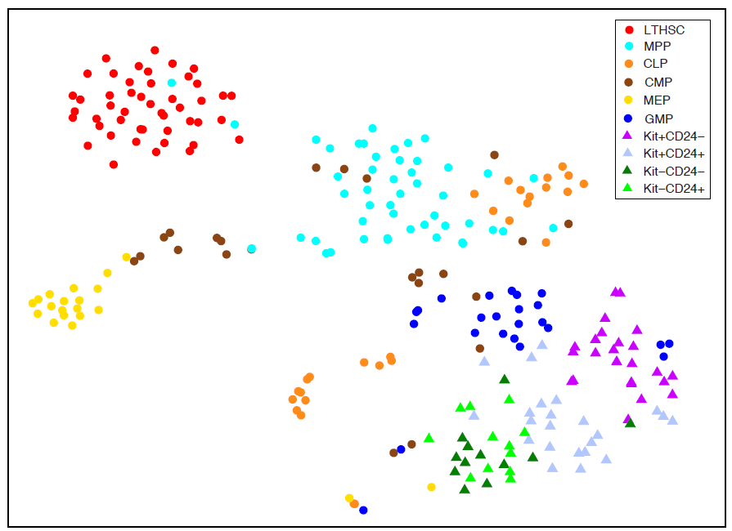
t-SNE analysis identifies similarities between cell-types
t-SNE is a nonlinear dimension reduction method, and can identify patterns undetectable by PCA
t-SNE minimizes the divergence between distributions over pairs of points.
Leukemia cells are more similar to GMPs than to HSCs
Leukemia cells are highly heterogeneous.

Slide 19
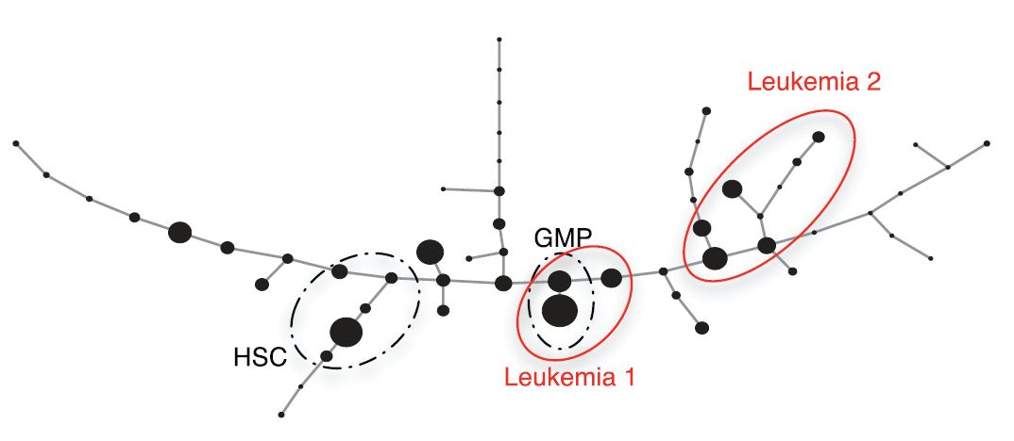
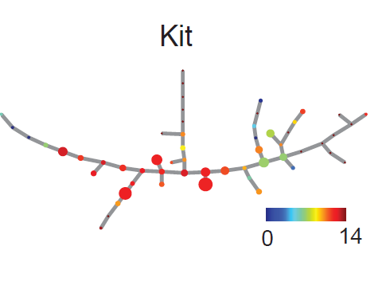
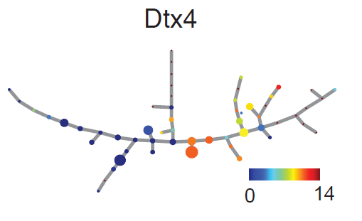
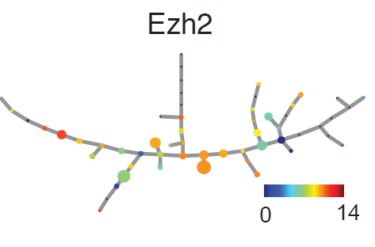
Mapping leukemia cells to normal hematopoietic cell hierarchy
Use 33 common genes to map cell hierarchy.
Mapping identifies two subtypes of leukemia cells.
These cells are similar but not identical to their corresponding normal lineages.

Slide 20
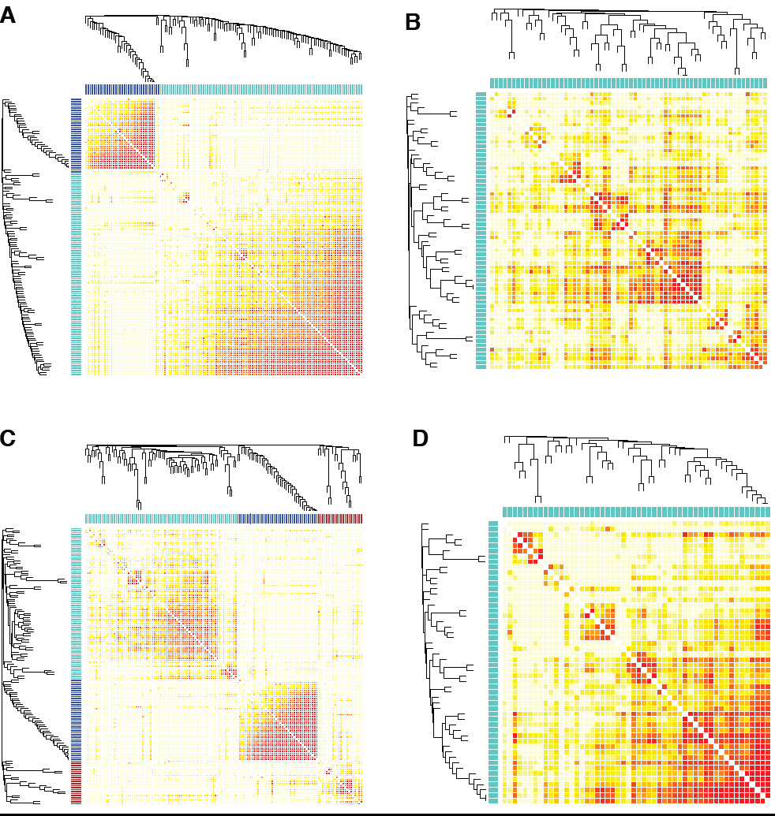
Coexpression networks are different among subtypes
All
Leukemia
GMP
Leukemia 1
Leukemia 2

Slide 21
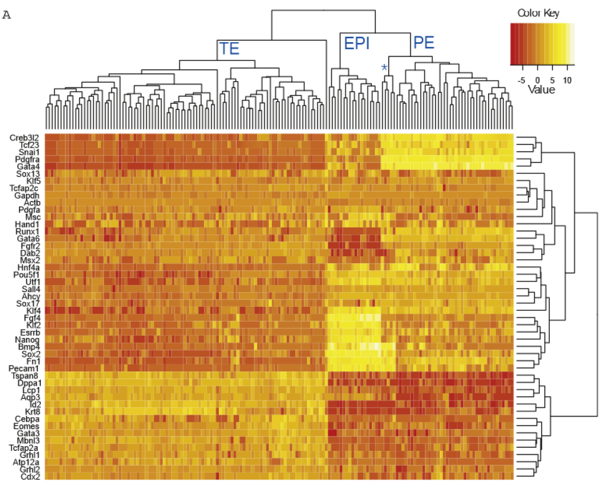
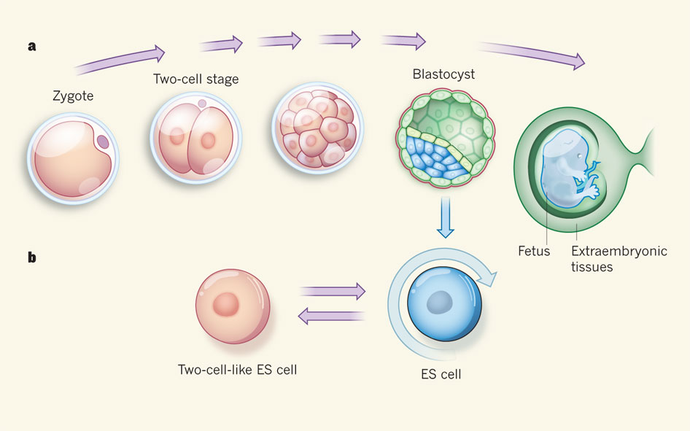
Surani and Tischler, Nature 2012
Guo et al. Dev Cell 2010

Slide 22
Dynamic clustering
T = 1
T = 2
T = 3
T = 4
Maximizing the penalized log-likelihood.
Eugenio Marco, Bobby Karp, Lorenzo Trippa, Guoji Guo

Slide 23
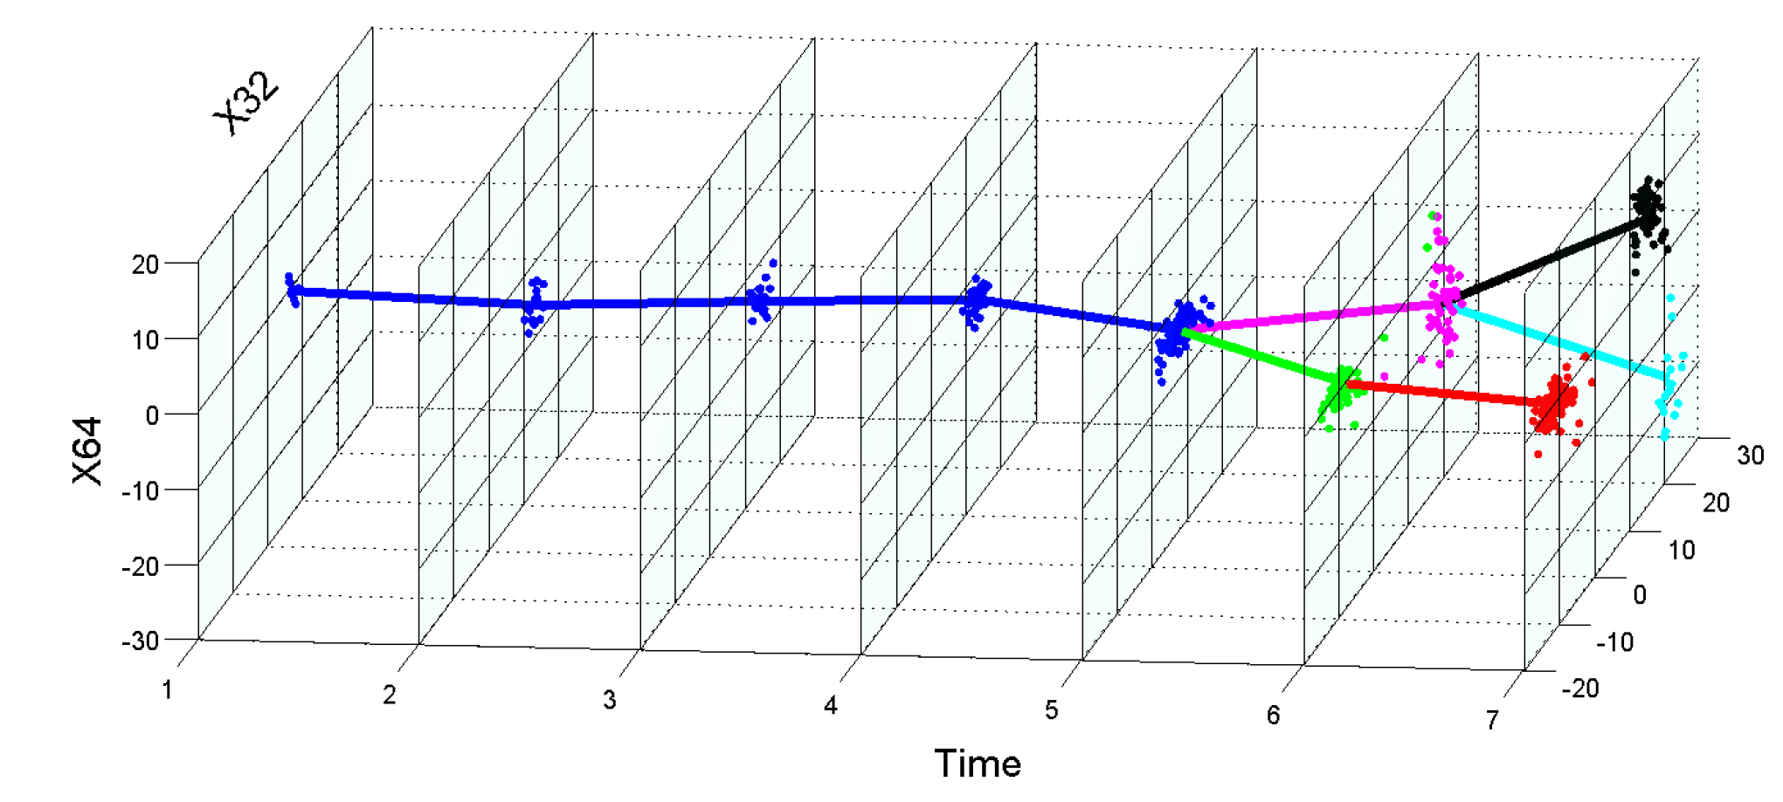
Identifying bifurcation points and directions
EPI
ICM
PE
TE
>80% variance increase during bifurcation is attributed to a single (bifurcation) direction.

Slide 24
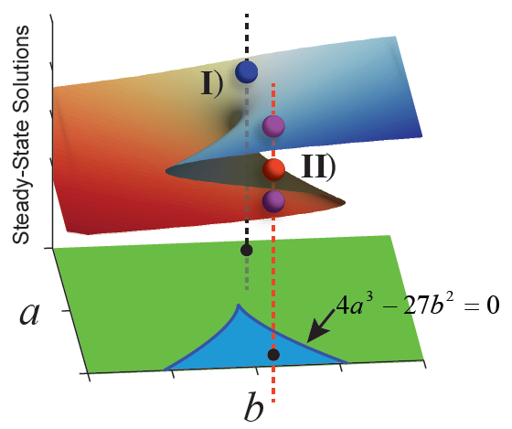
Modeling dynamics by bifurcation analysis
I)
U(x)
II)
U(x)

Slide 25
Modeling dynamics by bifurcation analysis
I)
U(x)
II)
U(x)

Slide 26
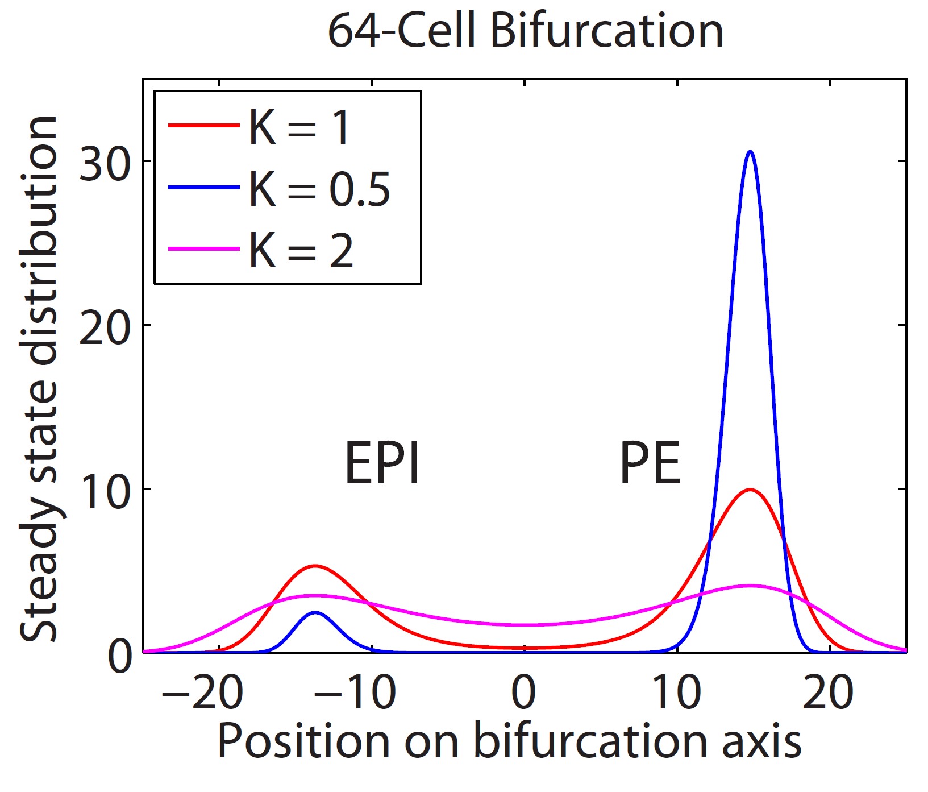
Noise level σ has large impact on lineage biases
= 1
= 0.5
= 2

Slide 27
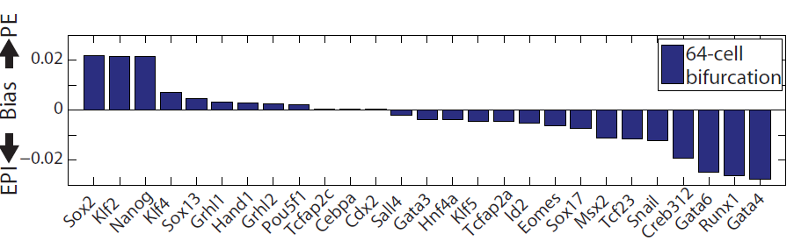
Lineage bias due to perturbation of TF activity
Control
Perturbation
U(x)
U(x)
Predicted lineage bias due to 2 fold decrease of TF level

Slide 28
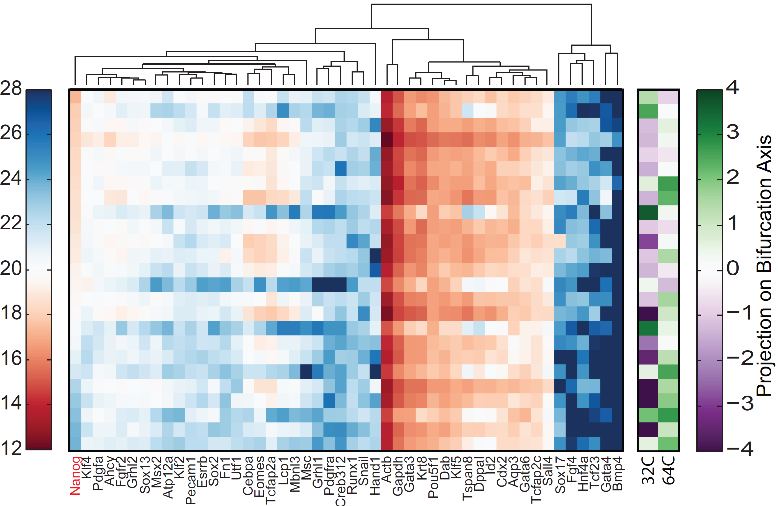
Experimental validation using Nanog mutant
PE
EPI
Nanog

Slide 29
How do we infer dynamics without temporal information?

Slide 30
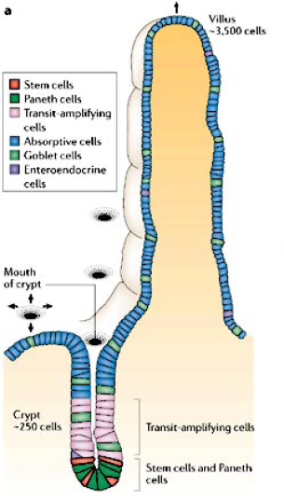
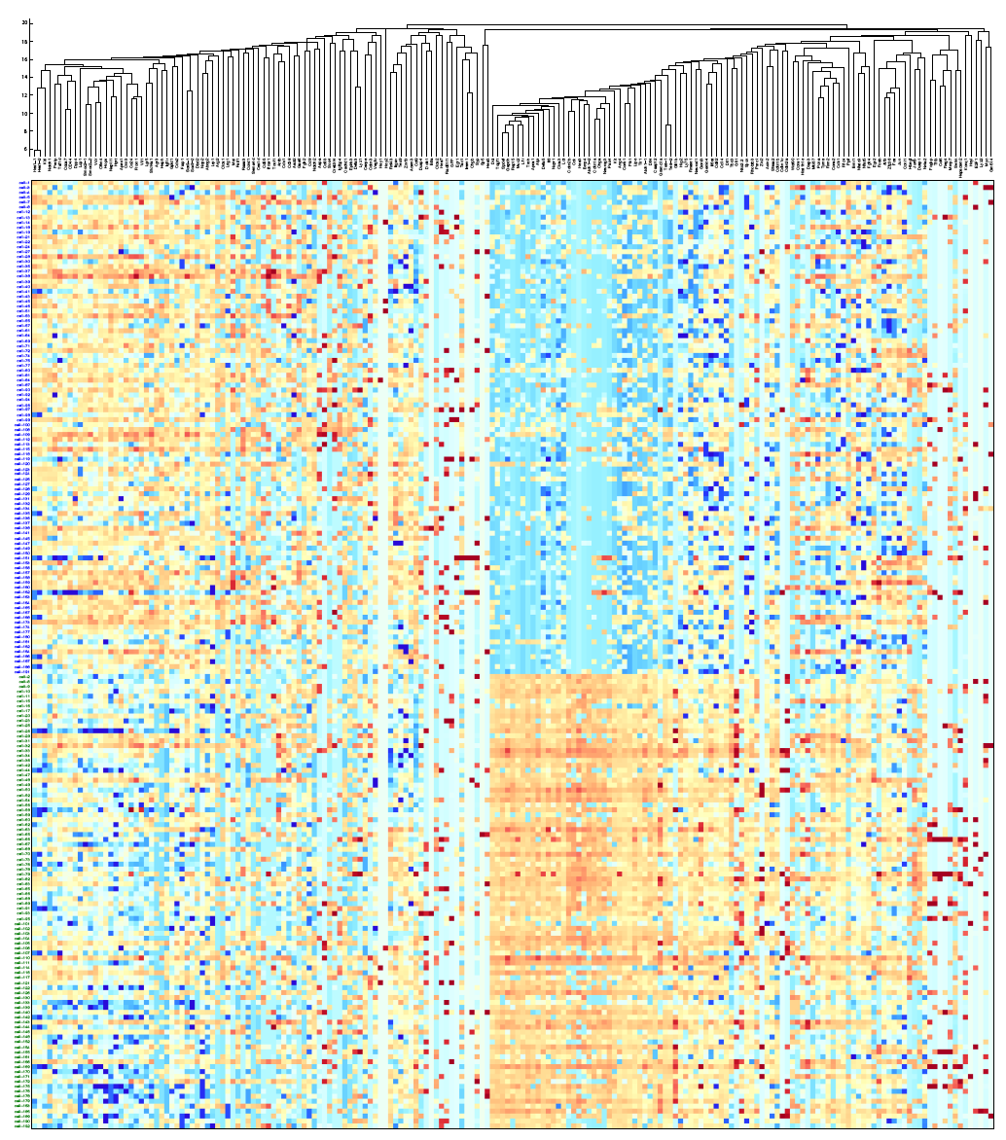
Characterization of early bipotential progeny of
Lgr5⁺ intestinal stem cells
Crosnier 2006. Nature Review
Tae-Hee Kim, Assieh Saadatpour

Slide 31
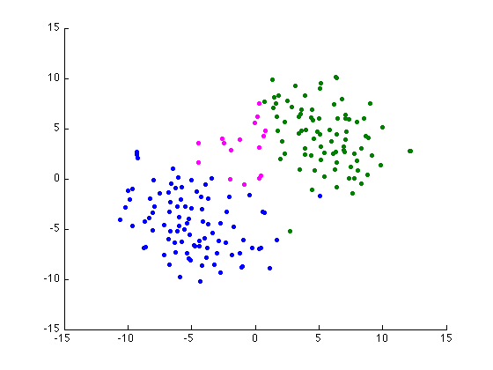
Principal Curve Analysis Reconstruct Temporal Information
t-SNE plot indicates two distinct clusters, linked a small number of transitional cells

Slide 32
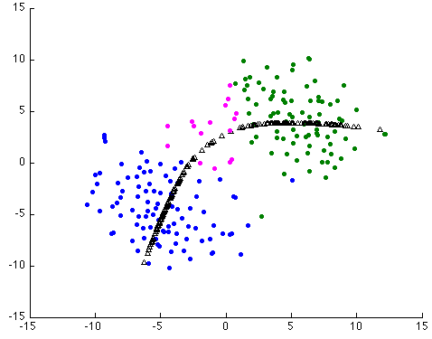
Principal Curve Analysis Reconstruct Temporal Information
t-SNE plot indicates two distinct clusters, linked a small number of transitional cells
Principal curve analysis captures the overall trend of cell-state transition

Slide 33
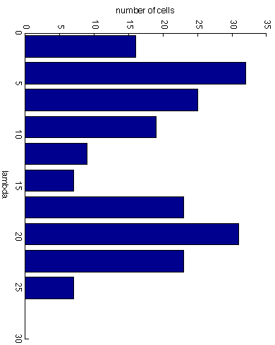
Inferred dynamic gene expression profile
Use the principal curve coordinate as a proxy for temporal evolution.

Slide 34
Conclusions
Single-cell genomics is a powerful technology for understanding cellular heterogeneity and hierarchy.
Single-cell gene expression data analysis present many new methodological challenges.
It is a great time to develop algorithms and software for single cell data analysis.

Slide 35
Acknowledgement
Eugenio Marco
Assieh Saadatpour
Bobby Karp
Lorenzo Trippa
Paul Robson
Stuart Orkin
Guoji Guo
Ramesh Shivdasani
Tae-Hee Kim
Funding from
NIH, HSCI

