Slide 1
Somatic alterations in human cancer genomes
Matthew Meyerson, M.D., Ph.D.
Dana-Farber Cancer Institute
Harvard Medical School
Broad Institute
Bioconductor Conference
Dana-Farber Cancer Institute
Boston, Massachusetts
July 31, 2014

Slide 2
Somatic genome alterations and cancer therapy

Slide 3
“Happy families are all alike; every unhappy family is unhappy in its own way”.
Leo Tolstoy, Anna Karenina
Every cancer genome is uniquely altered from its host normal genome
Normal human genomes are all (mostly) alike; every cancer genome is abnormal in its own way.
Each cancer genome has a unique set of genome alterations from its normal host
These alterations, however, are not random but act in common pathways and mechanisms

Slide 4
Somatic genome alterations are central to cancer pathogenesis
While germ-line mutations can increase the risk of cancer, most cancer causing mutations are somatic
  Somatic mutations are present in the cancer DNA but not in the germ-line DNA
Somatic alterations can provide a large therapeutic window
  Genome-targeted treatments can be selective for the genomically altered cancer cell and spare the rest of the body, which is genomically normal
Somatic alterations are internally controlled
  Comparison between germ-line and cancer defines the cancer-specific alterations and allows precise diagnosis

Slide 5
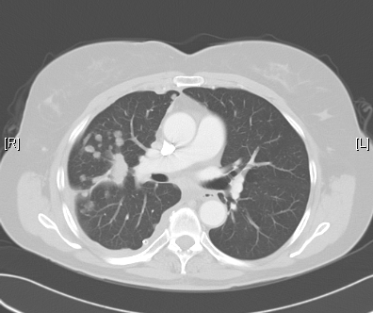
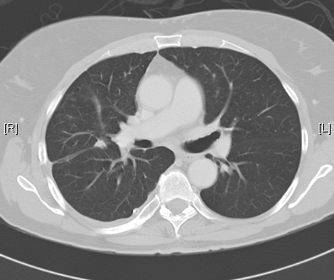
Mutation-targeted therapies can be highly effective in cancer treatment
After 2 months erlotinib treatment
Before treatment
Response to erlotinib (Tarceva) treatment of a patient with lung adenocarcinoma, with a somatic EGFR deletion mutant in exon 19 ( thanks to Bruce Johnson, M.D., DFCI)

Slide 6
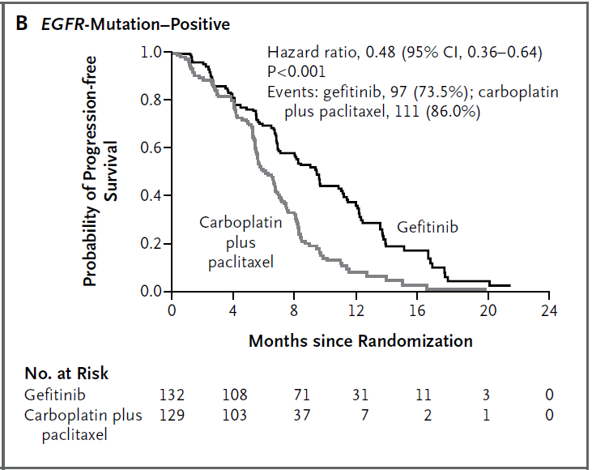
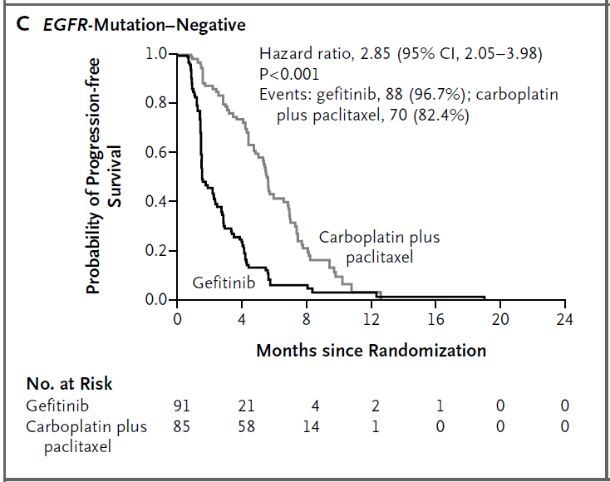
Often, only patients whose cancers have mutated therapeutic targets will benefit from targeted therapy
Patients with EGFR mutant lung cancer benefit from gefitinib
While those with EGFR wild type lung cancer do not benefit
Mok et al., NEJM, 2009

Slide 7
A growing armamentarium of genomically targeted cancer therapies
Gene | Mechanism of Activation | Targeted Inhibitor
ABL | rearrangement | imatinib, dasatinib, nilotinib, bosutinib
ALK | rearrangement, mutation | crizotinib
BRAF | mutation, rearrangement | vemurafenib, dabrafenib
DDR2 | mutation | dasatinib
EGFR | mutation | erlotinib, gefitinib, afatinib, cetuximab, panitumumab
ERBB2 | mutation, amplification | trastuzumab, lapatinib, pertuzumab
FGFR1 | amplification, rearrangement | ponatinib
FGFR2 | mutation, rearrangement | ponatinib
FGFR3 | mutation | ponatinib
KIT | mutation | imatinib, sunitinib, regorafenib, pazopanib
MET | amplification, mutation | crizotinib
PDGFRA | mutation, rearrangement | imatinib, sunitinib, regorafenib, pazopanib
RET | rearrangement, mutation | cabozantinib
ROS1 | rearrangement | crizotinib

Slide 8
Application of high-throughput genomic analysis to cancer

Slide 9
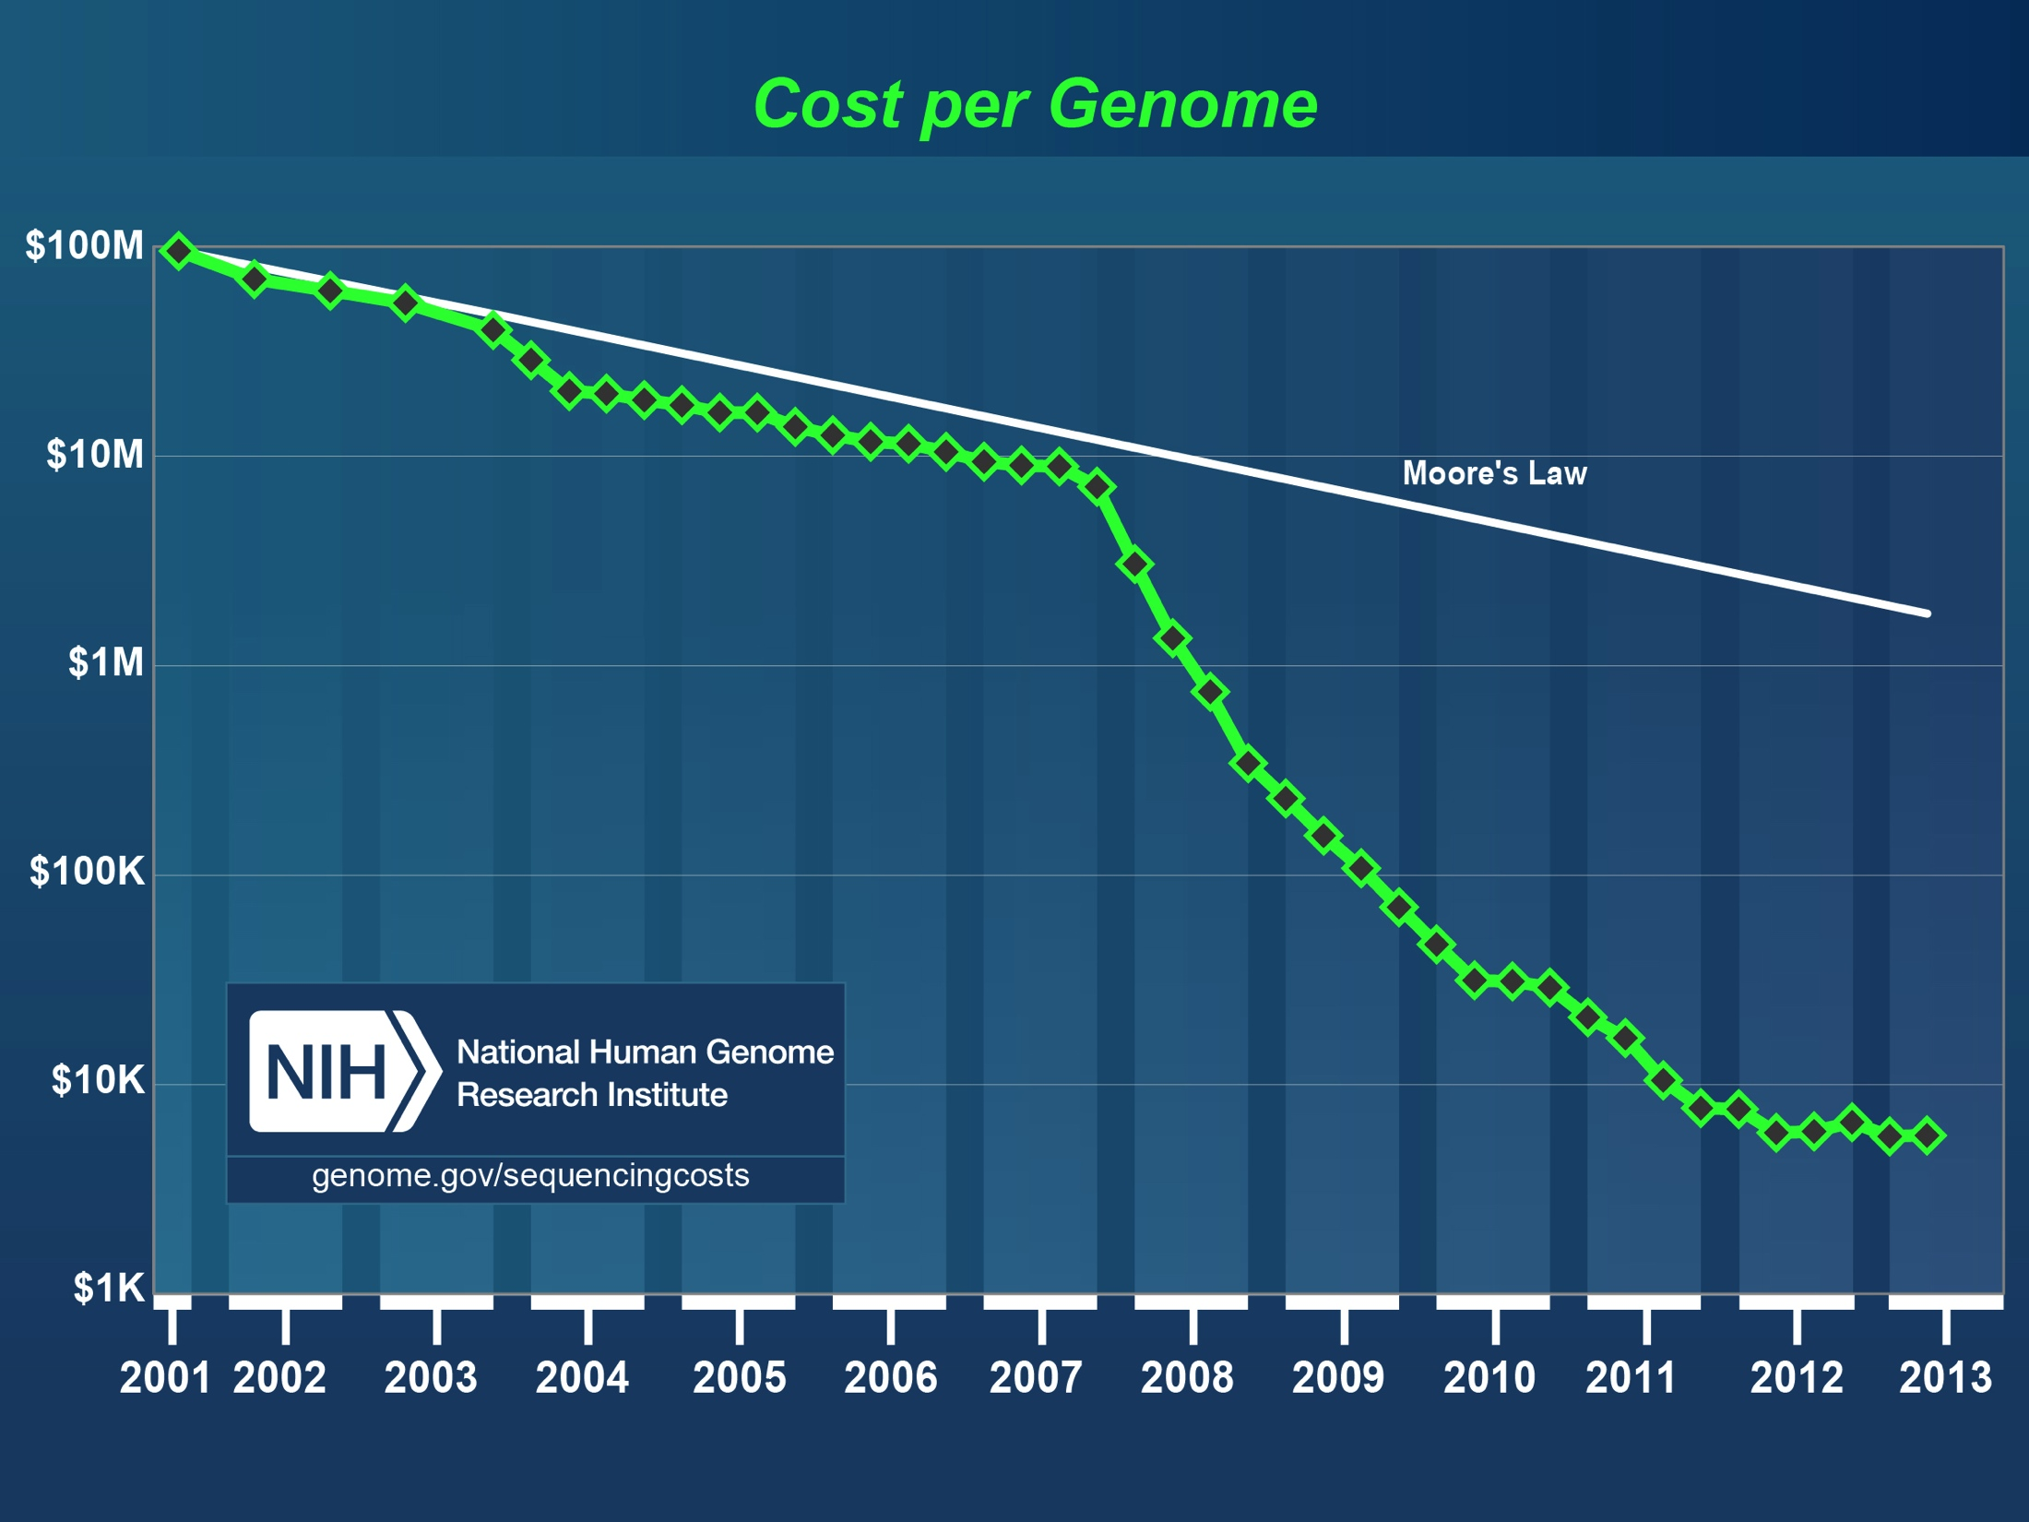
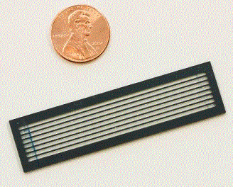
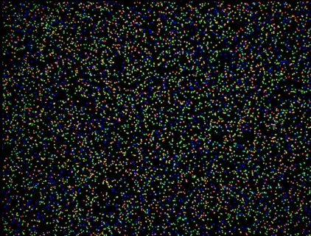
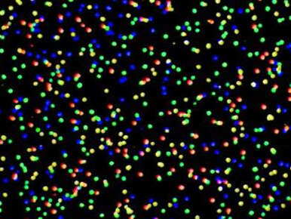
Increasing power of genome sequencing technology

Slide 10
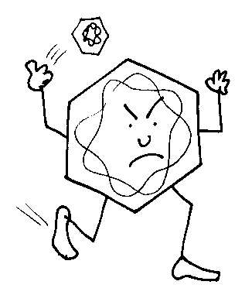
Genomic mechanisms of cancer
(germline and somatic)
Mutation
Amplification/deletion
Infection
AGT
Arg
CGT
Cys
TGT
Ser
GGT
Gly
Translocation
GAT
Asp
GCT
Ala
GTT
Val

Slide 11
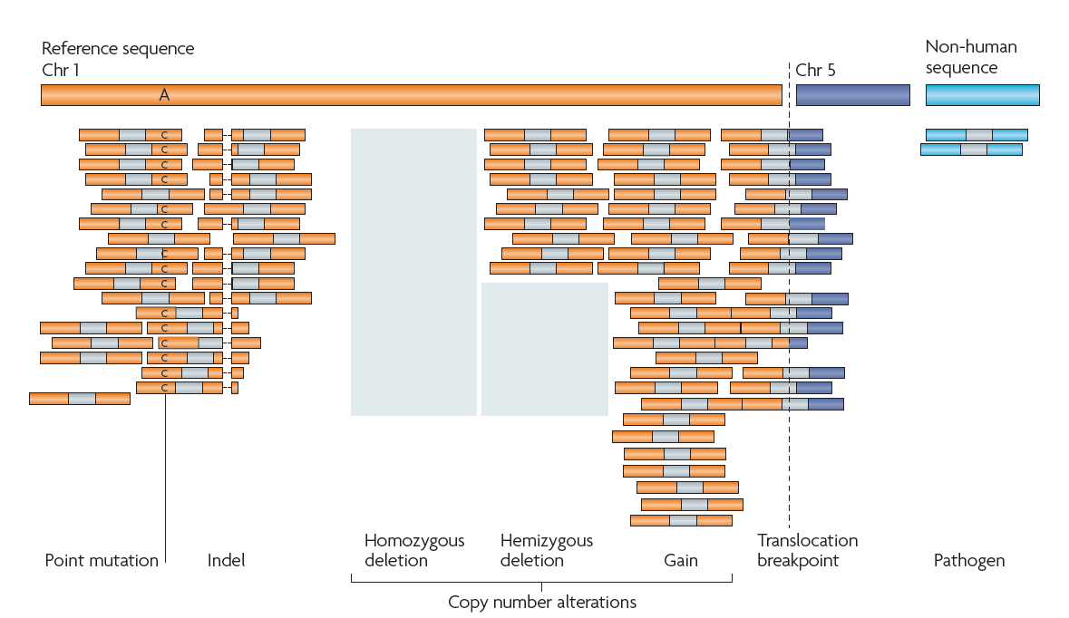
Sequencing can discover all classes of cancer genome alteration
Meyerson, Gabriel, Getz, Nat Rev Genet, 2010
Notes:
11
11
So what can we detect from Whole genome or whole exome or transcriptome sequencing.
We get paired end reads, map them to the genome and can find : ……
Find rearrangements and map them to the single base resolution.

Slide 12
Approaches to cancer genome sequencing
Whole genome
Complete sequence of entire genome (3 billion bases—currently typically 30x coverage)
Transcriptome
Sequencing of all messenger RNAs
Whole exome
Complete sequence of all exons of coding genes (~30 million bases, currently typically 150x coverage)
Targeted exome/plus
Complete sequences of exons and rearrangement sites from selected cancer-related genes, such as oncogenes and tumor suppressor genes (can achieve up to 1000x coverage)

Slide 13
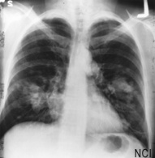
The Cancer Genome Atlas (TCGA)
More than 30 cancer histologies, incl…
10,000 cancer/normal paired specimens
Exome & transcriptome sequencing, copy number & methylome analysis, …
Biospecimen Core
Resource
Cancer Genomic
Characterization Centers
Genome
Sequencing
Centers
Genome Data Analysis Centers
Data Coordinating Center
Clinical diagnosis
Treatment history
Histologic diagnosis
Pathologic report/images
Tissue anatomic site
Surgical history
Gene expression/RNA sequence
Chromosomal copy number
Loss of heterozygosity
Methylation patterns
miRNA expression
DNA sequence
RPPA (protein)
Subset for Mass Spec
Lung adenocarcinoma
Lung squamous carcinoma
Breast carcinoma
Colorectal carcinoma
Renal cell carcinoma
Endometrial carcinoma
Glioblastoma
Ovarian carcinoma
Bladder carcinoma
HNSCC
Acute myeloid leukemia
Whole genome sequencing underway for 1000 cancer/normal pairs

Slide 14
How do we find a cancer gene?
How do we define a therapeutic target?

Slide 15
Genome alterations in squamous cell lung carcinoma: an illustration of computational and experimental issues in cancer gene discovery

Slide 16
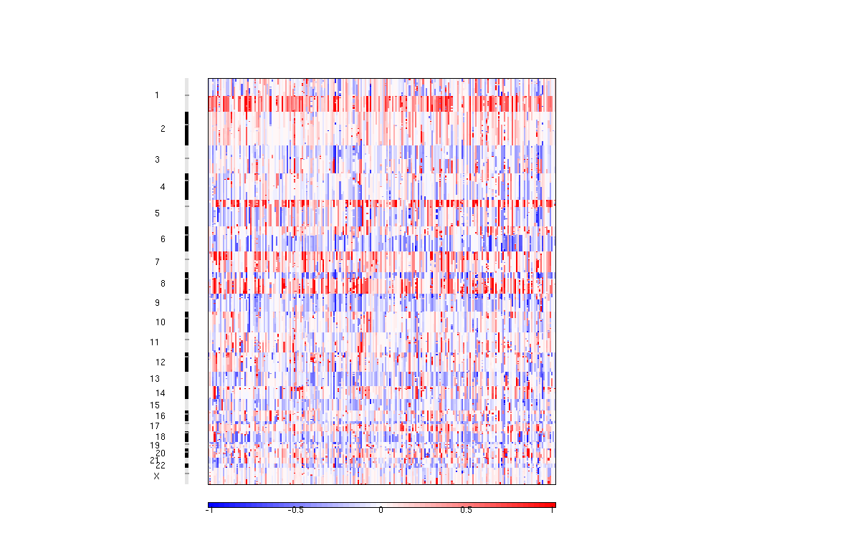
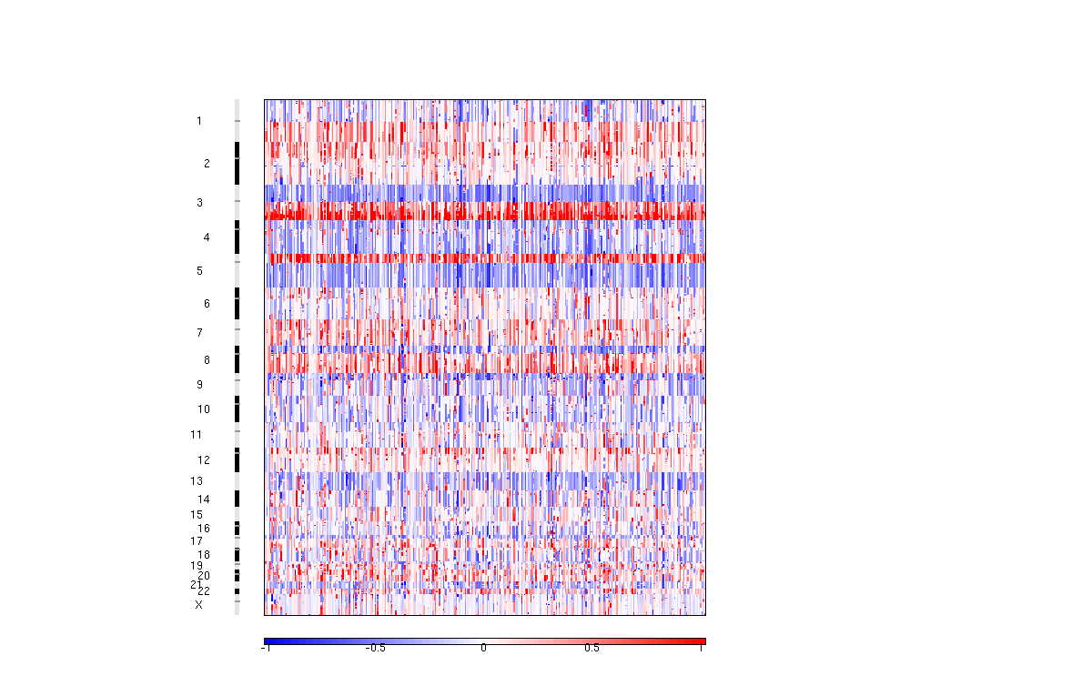
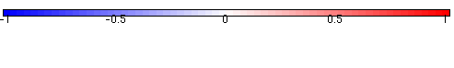
Lung cancers are characterized by common chromosome arm level alterations
Lung adenocarcinoma
Squamous cell lung carcinoma
Some differences between SqCC and AdC.
Loss
Gain
Andrew Cherniack, TCGA

Slide 17
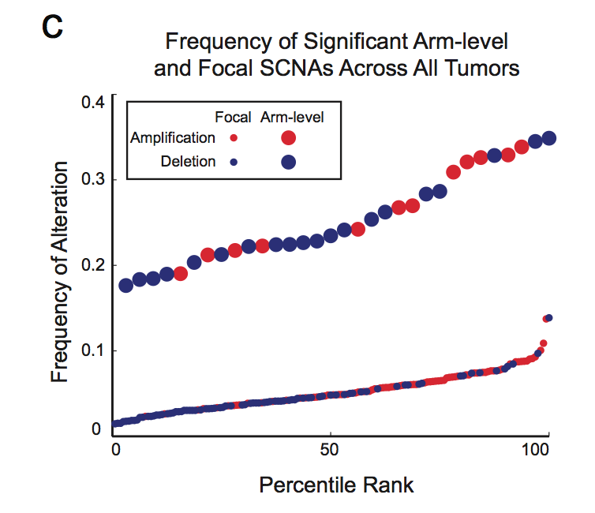
Arm-level chromosomal alterations are approximately the most common somatic genome alteration across all human cancers
Most frequently somatically mutated genes (exome):
TP53: 36%
PIK3CA: 14%
PTEN: 8%
Source:
www.tumorportal.org
Beroukhim et al., Nature, 2010

Slide 18
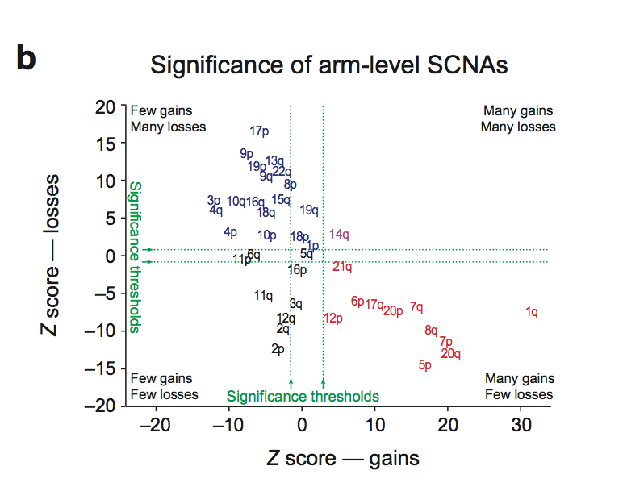
Athough there are tumor-type specific differences, most chromosome arms are either recurrently gained or recurrently lost, not both
Beroukhim et al., Nature, 2010

Slide 19
Do chromosome arm level alterations contribute to cancer? And if so, how?
Does the statistical recurrence imply that the chromosome arm-level gains and losses are important, or merely tolerated?
If chromosome arm level copy changes are important, are they do to single genes or multiple genes per arm?
Or are they due to systemic effects on the genome?
On the computational level, what are effects of individual arm level copy changes, and total aneuploidy, on gene expression within tumors?

Slide 20
Focal chromosome alterations in lung cancers
Lung adenocarcinoma
Squamous cell lung carcinoma
9p loss
14q gain
Loss
Gain
Andrew Cherniack, TCGA

Slide 21
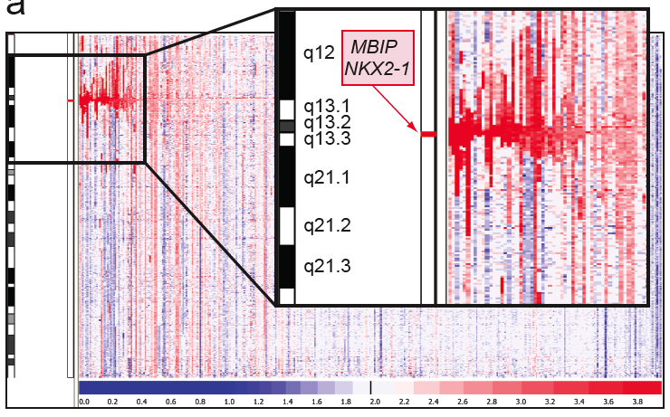
Copy number structure of most common amplification in lung adenocarcinoma (14q13) mapping to NKX2-1
Barbara Weir & Gaddy Getz

Slide 22
Finding targets of focal genome alterations:
Statistical recurrence is key to defining genome alterations but we need to find the right background model by understanding the biological variations in the genome

Slide 23
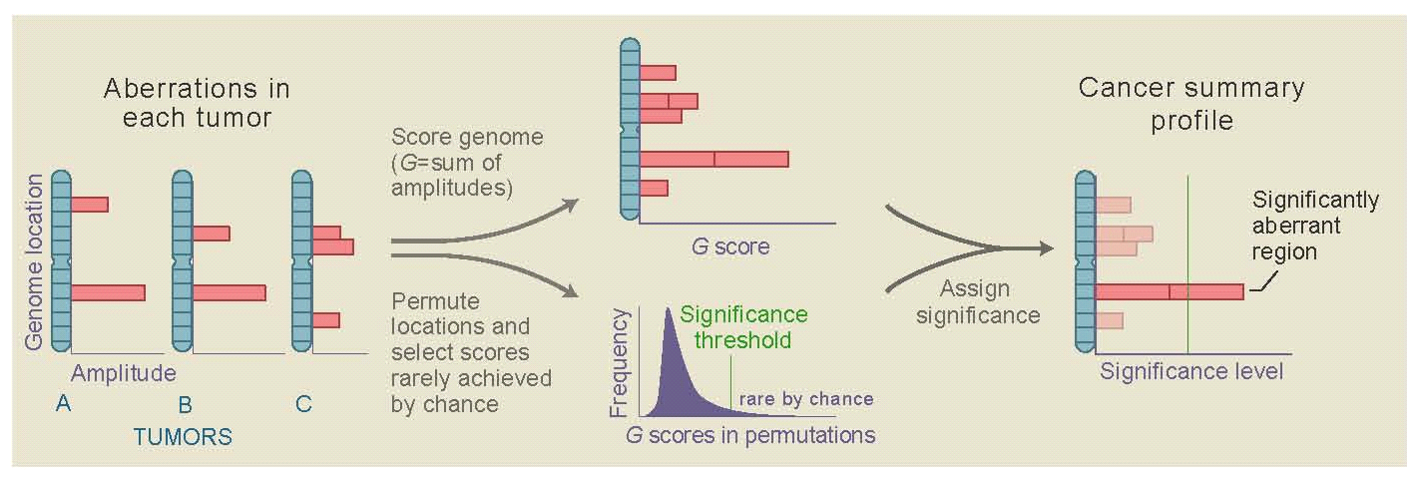
Evaluating significance of copy number alterations:
Genomic Identification of Significant Targets In Cancer (GISTIC)
Measure the amplitude of copy number gain or loss at each position in each sample
Sum this amplitude across all samples
Assign significance for the alteration (false discovery rate) by comparison to randomly permuted data
Beroukhim, Getz et al. , PNAS, 2007

Slide 24
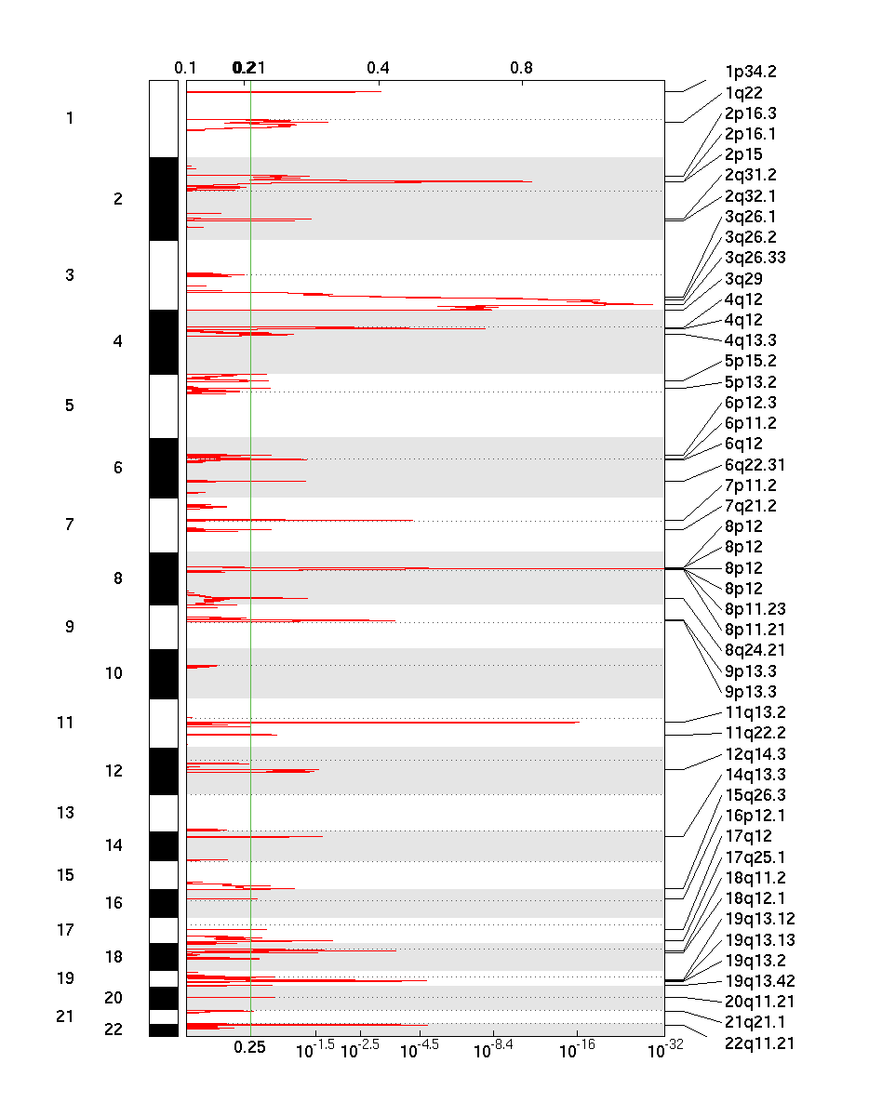
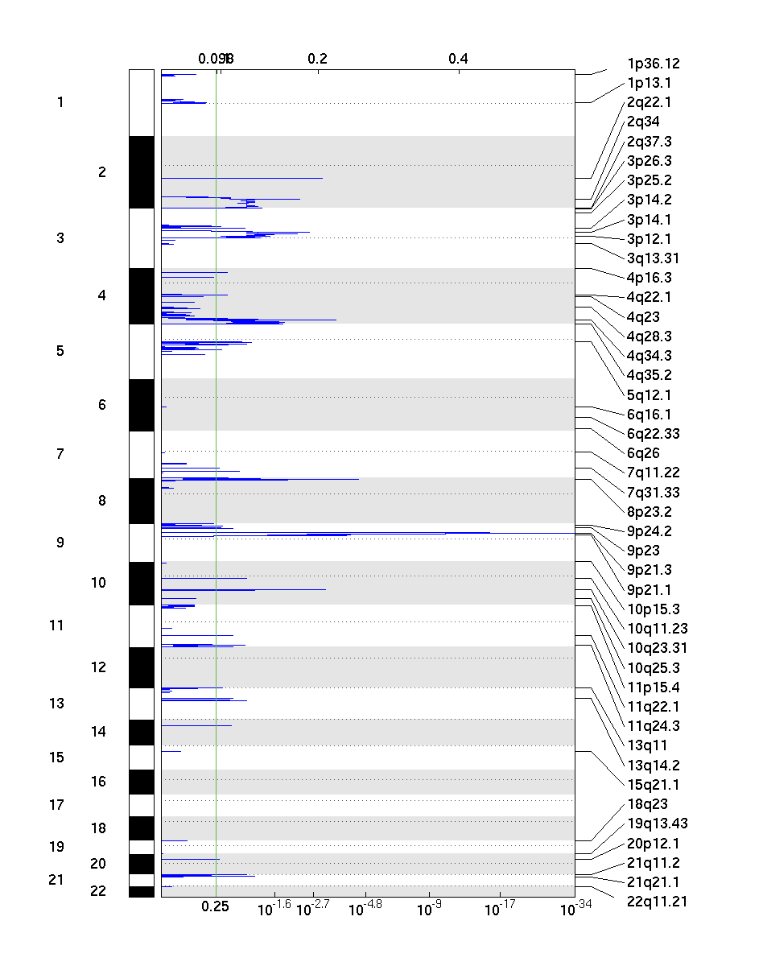
Focal copy number alterations in squamous cell lung carcinoma
Amplification
Deletion
MCL1
MYCL
REL
LRP1B
NFE2L2
ERBB4
SOX2
FOXP1
PDGFRA
EGFR
CSMD1
FGFR1
CDKN2A
PTEN
CCND1
MDM2
RB1
ERBB2
CRKL
TCGA, Nature, 2012

Slide 25
Problem: can we build a statistical model for focal chromosomal alterations that allows us to identify all copy number altered oncogenes and tumor suppressor genes?

Slide 26
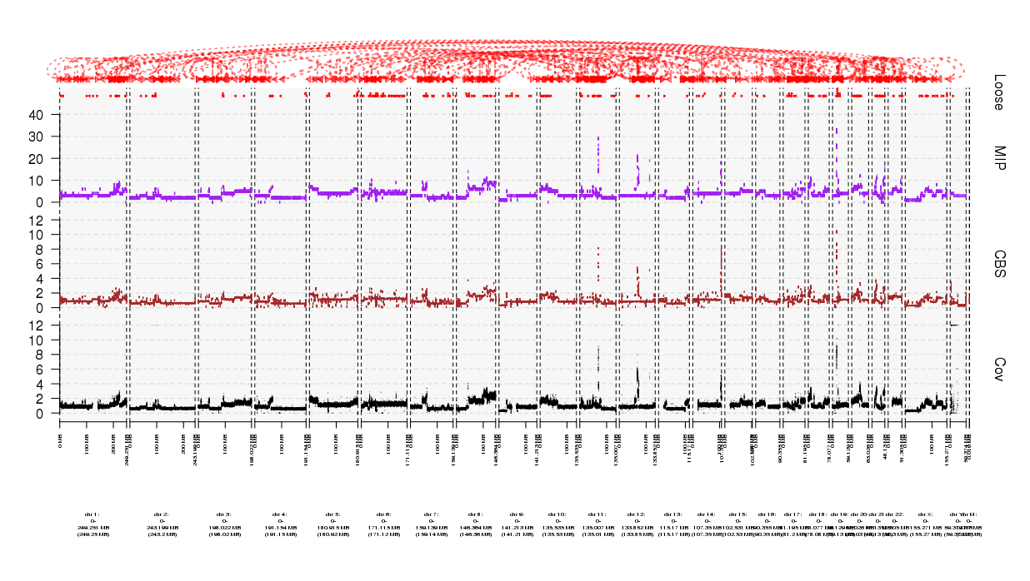
Challenge: genome is complex with many rearrangements
Rearrangement junctions
Notes:
700 segments vs 3500

Slide 27
A better model for determining significance of copy number alterations could be built from whole genome sequence data and would require understanding of genome structure

Slide 28
How to find significant mutations in cancer over background?

Slide 29
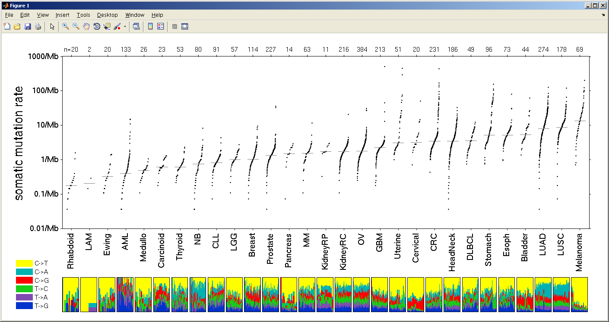
Squamous cell lung cancer has a very high rate of somatic mutations
Hematologic
Childhood
Carcinogens

Slide 30
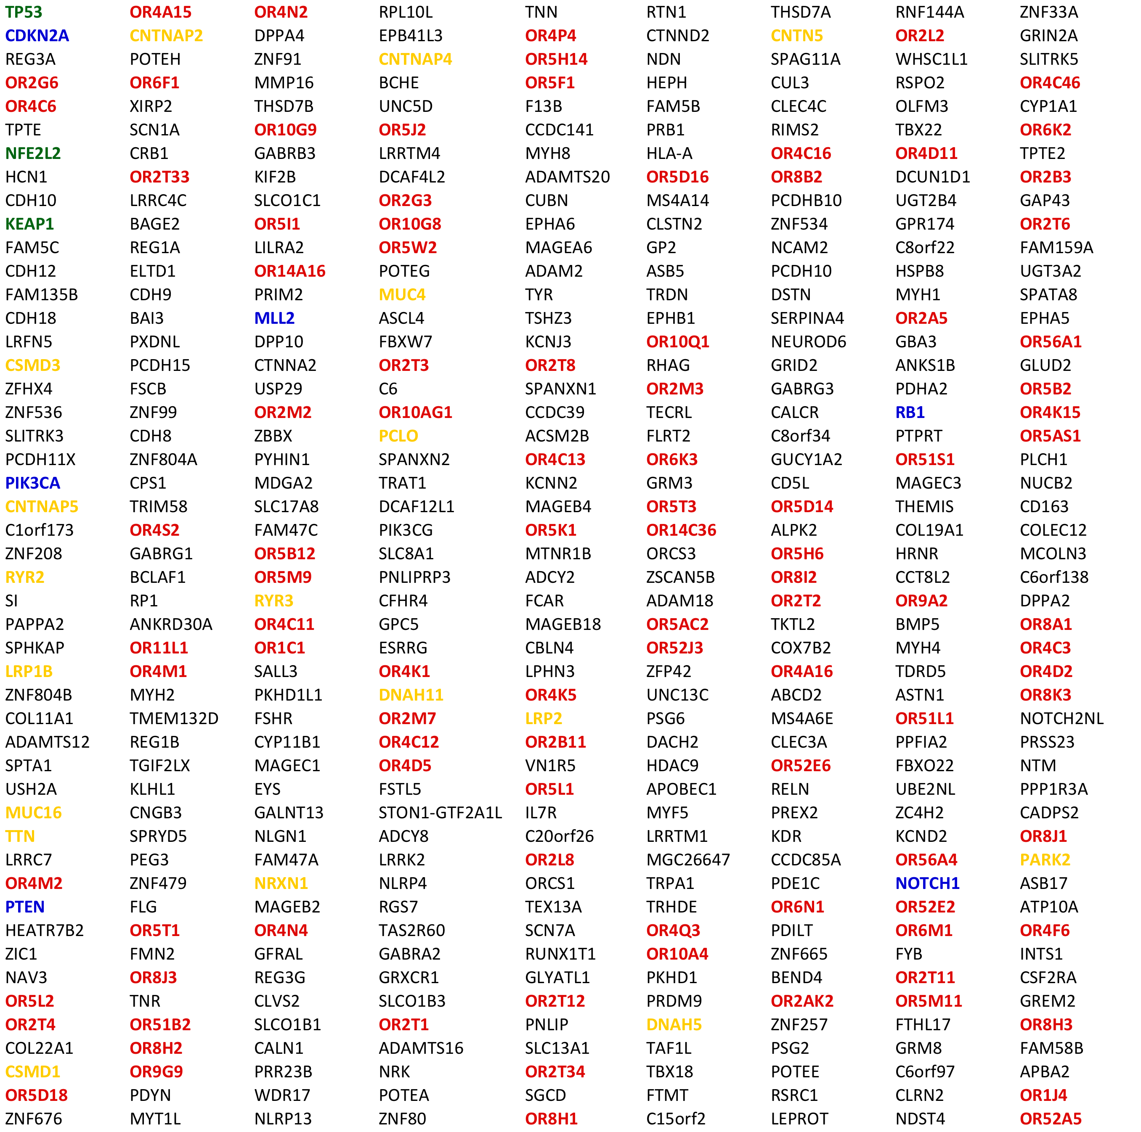
Top mutated genes in squamous cell lung cancer (crude analysis)

Slide 31
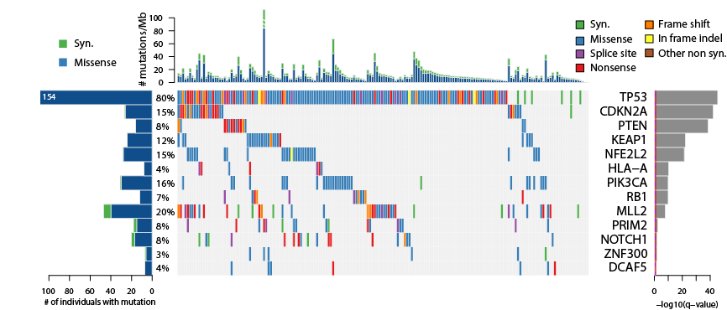
Top mutated genes in squamous cell lung cancer (expression-filtered significance)
TCGA, Nature, 2012

Slide 32
The problem of mutation significance is even larger in whole genome sequence data
The problem of background mutation rate is particularly high in regions of non-coding DNA/heterochromatin
We see up to about 50-fold variation in mutation rates between regions of the genome
What is the best model to correct for this
Peter Hammerman, Akin Ojesina

Slide 33
Splicing factor alterations: what are their transcriptome consequences

Slide 34
Significantly mutated genes in lung adenocarcinoma
Imielinski et al., Cell, 2012

Slide 35
Somatic mutations can disrupt mRNA splicing regulation
U2AF1
(U2AF35)
Splicing factors
SF3B1
Splicing regulatory sequences
GU
YUNAY
YYYYY
UGUGAA
AG
GAACCA
branch
point
enhancer
5’ss
polypyrimidine
tract
3’ss
enhancer
Notes:
- Also mention chromatin and methylation also affects splicing as well.

Slide 36
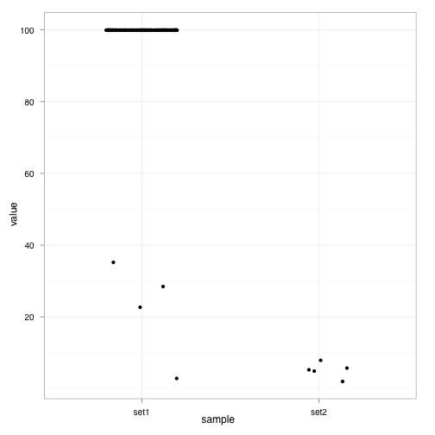
Alternative splicing of MET exon 14 in TCGA lung adenocarcinoma RNA sequencing data
Normal MET transcript: contains exon 14 in 220 samples
Percent Spliced In, %
Y1003*
3’ss 19bp del
Abnormal MET transcript: lacks exon 14 in 10 samples
5’ss +3
Kong-Beltran et al. 2006, Onozato et al. 2009; Seo et al., 2012
5’ss 12bp del
No MET splice site mutation
MET splice site mutation
TCGA/Angela Brooks

Slide 37
All MET exon 14 skipping samples are, otherwise, oncogene negative
Percent Spliced In, %
TCGA/Alice Berger
No MET splice site mutation
MET splice site mutation
n=224
n=6, one sample has low expression

Slide 38
Transcriptome / “spliceome” correlates to genome alterations
Effects of cis mutations on transcriptome—both near and far
Effects of trans mutations (e.g. splicing factor mutations) on specific gene splicing
  On specific gene expression
  On global gene expression

Slide 39
Pathogen Discovery from Sequencing Data
Alex Kostic
Chandra Pedamallu
Akin Ojesina
Joonil Jung
Ami Bhatt

Slide 40
Sequence-based computational subtraction for pathogen discovery
Principle
The human genome sequence is nearly complete
Infected tissues contain human and microbial RNA and DNA
Generate & sequence libraries from human
tissue
Normal human sequences can be subtracted computationally
Computational
subtraction
Remainder is of non-human origin:
disease-specific sequences can be validated experimentally
Weber et al., Nature Genetics, 2002

Slide 41
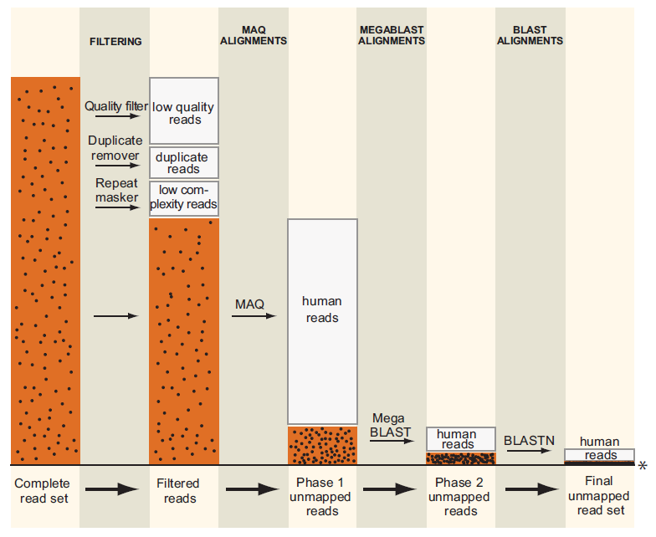
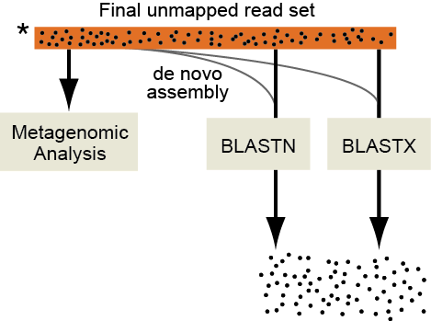
PathSeq: software to identify or discover microbes by deep sequencing of human tissue
Kostic et al., Nature Biotechnology, 2011
Notes:
-here’s how it works
-dots
-filtering…alignments to reference human genomes and transcriptomes
-first – bulk
-slower – senstive
-enriched
-assembly and alignment-based approaches

Slide 42
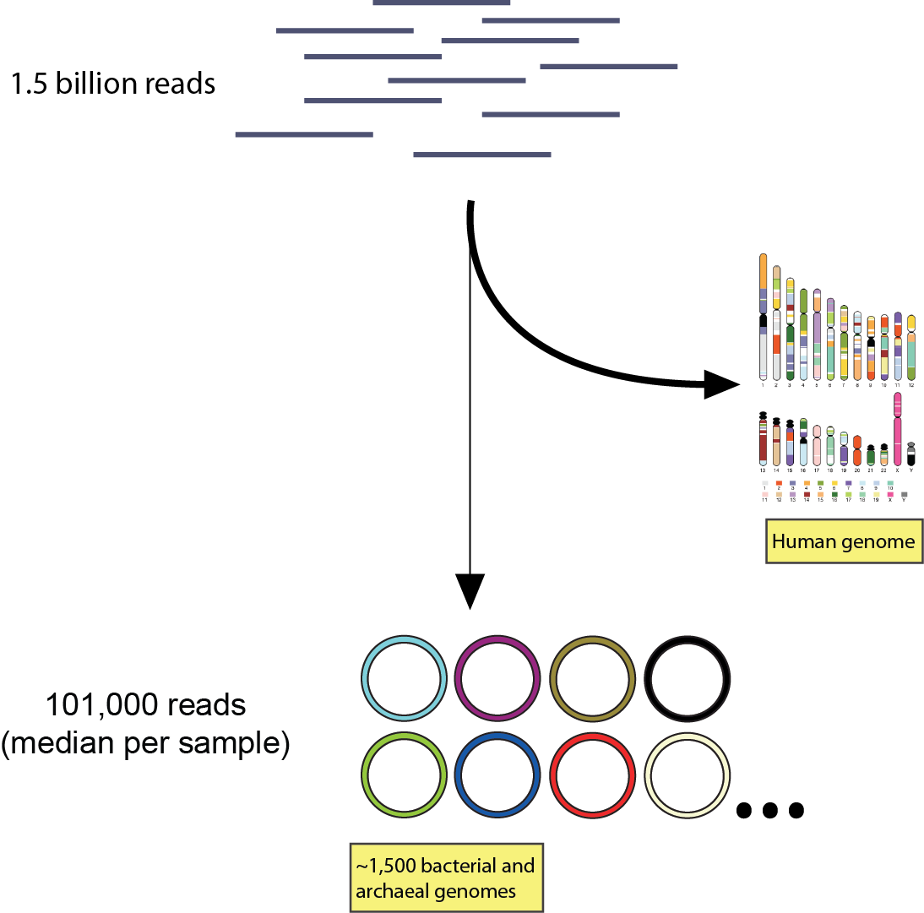
Pathogen analysis of 9 colorectal cancer/normal genome pairs
PathSeq
Notes:
-300 species
-tiny fraction of input, but
-rich dataset to start cataloguing the microbiome

Slide 43
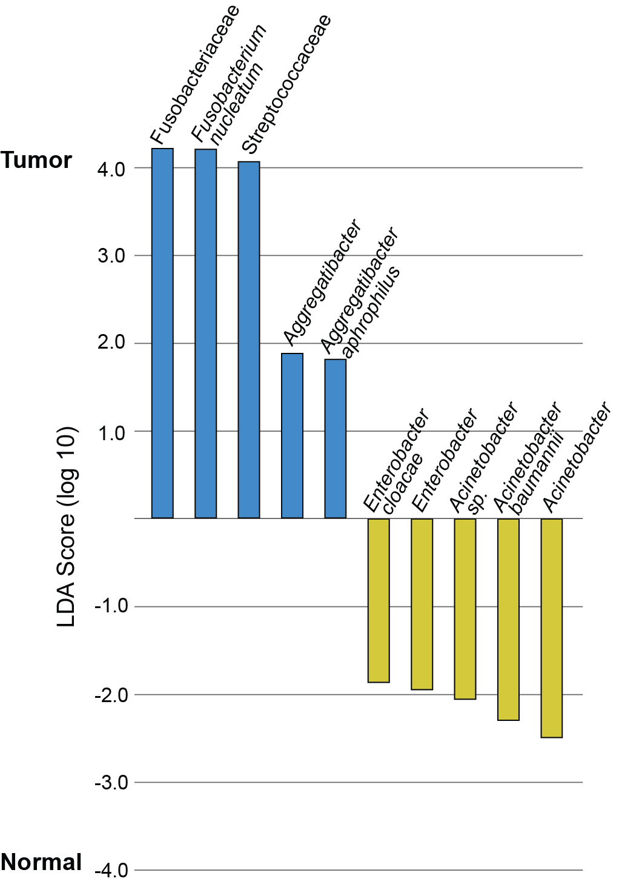
Initial analysis identifies tumor-enrichment of Fusobacterium and Streptococcaceae
LEfSe: Linear Discriminant Analysis (LDA)
coupled with effect size measurements
Wilcoxon sum-rank test followed by LDA analysis
Segata et al., 2012
Kostic et al., Genome Research, 2012

Slide 44
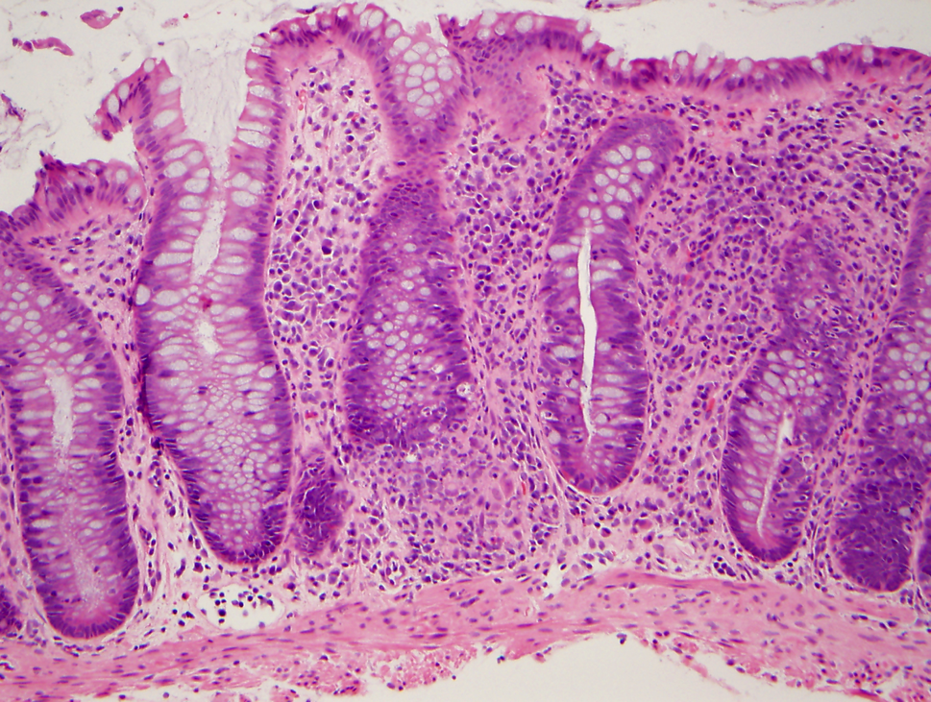
Cord Colitis Syndrome
Idiopathic, antibiotic-responsive diarrheal syndrome
Affected umbilical cord blood transplant patients between ~60d and 1y after transplantation
11 histopathologically confirmed cases between 2004-2011 at BWH
All microbiology studies negative
Herrera AF, Soriano G et al. NEJM 2011

Slide 45
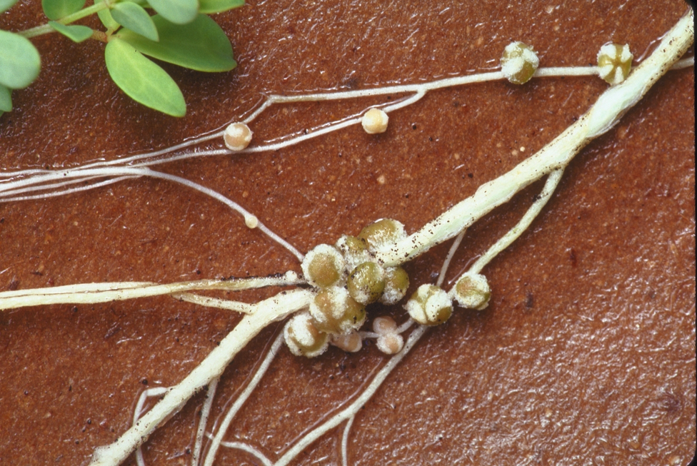
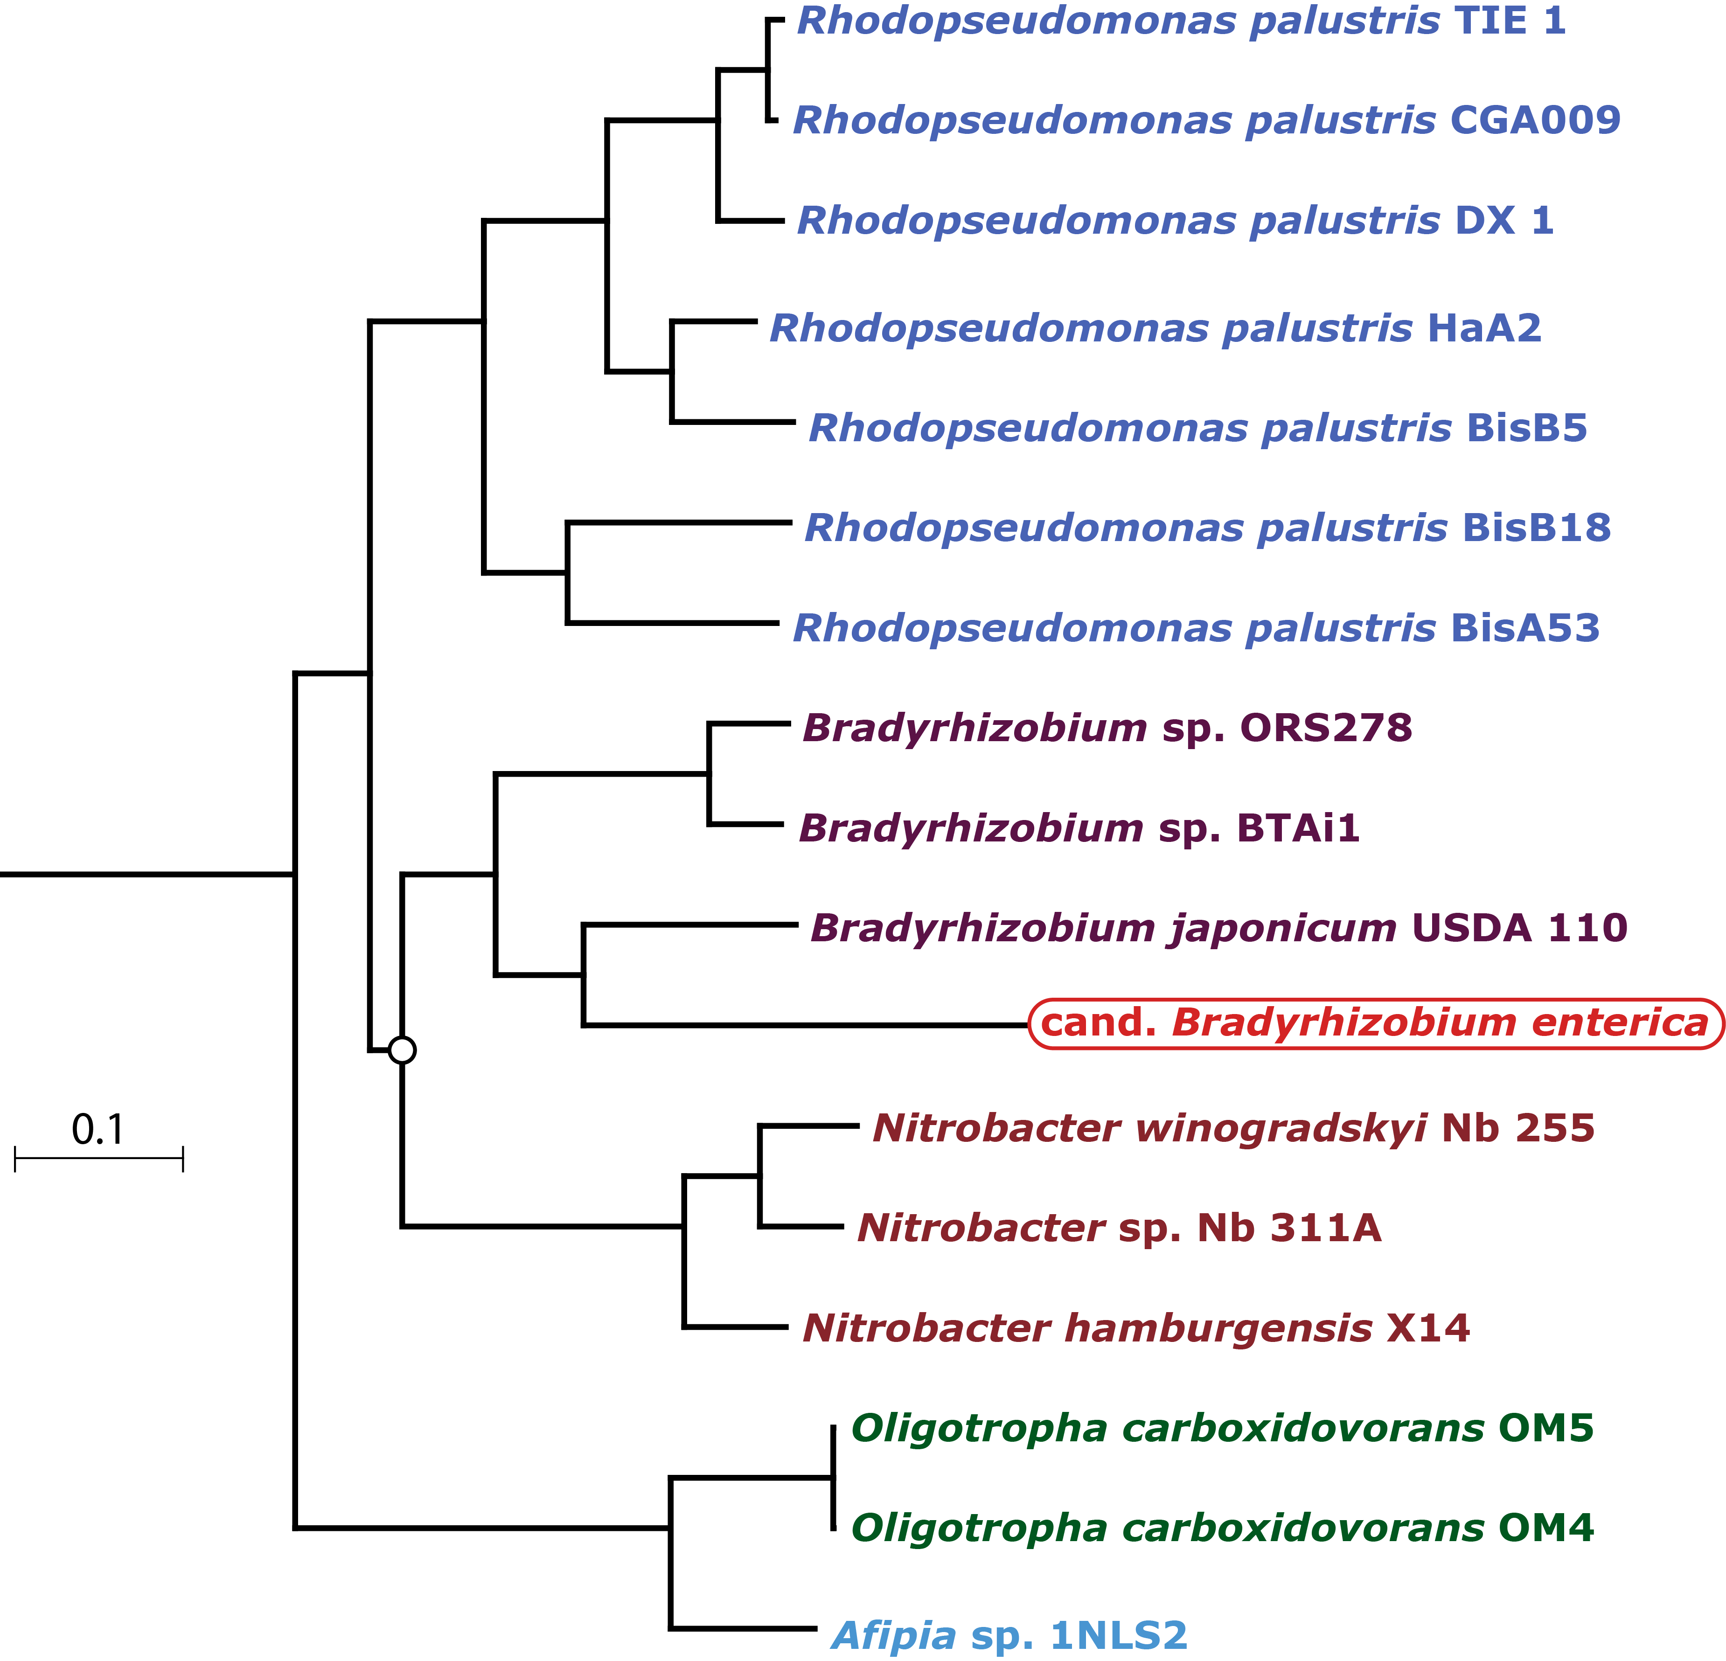
Classification of the CCS-associated bacterium
Phylogenetic analysis using the draft genome to classify the organism
Comparison of B. enterica to B. japonicum
Filamentous hemagglutinin genes
Genes critical for Carbon fixation
CCS organism
PhyloPhlAn
N. Segata, C. Huttenhower

Slide 46
Challenges in sequence-based pathogen discovery
How to analyze unclassified/unclassifiable reads
Developing a fast algorithm for very large data sets
Assignment of reads to nearest organisms

Slide 47
Summary: some challenges in somatic cancer genomics
Whole genome and whole transcriptome sequencing provide unprecedented opportunities for understanding cancer development and evolution
...but require development of many computational tools
  New models for copy number significance (and rearrangement significant) using whole genome sequence data and developing appropriate background models
  Ways to determine significance of non-coding mutations with appropriate background models
  Finding non-human sequence data in large sequencing data sets to find new disease organisms

Slide 48
Acknowledgements
Meyerson laboratory
Alice Berger
Ami Bhatt
Angela Brooks
Scott Carter
Andrew Cherniack
Juliann Chmielecki
Peter Choi
Luc de Waal
Josh Francis
Hugh Gannon
Heidi Greulich
Elena Helman
Bryan Hernadez
Marcin Imielinski
Joonil Jung
Bethany Kaplan
Nathan Kaplan
Alex Kostic
Rachel Liao
Wenchu Lin
Akinyemi Ojesina
Chandra Pedamallu
Trevor Pugh
Tanaz Sharifnia
Alison Taylor
Hideo Watanabe
Cheng-Zhong Zhang
Selected alumni
Jordi Barretina, Novartis
Jeonghee Cho, Samsung
Tom Laframboise, Case Western
Se-Hoon Lee, Seoul National U.
Katsuhiko Naoki, Keio U.
Orit Rozenblatt-Rosen, Broad Institute
Xiaojun Zhao, Novartis
Dana-Farber Cancer Institute colleagues
Adam Bass
Rameen Beroukhim
Michael Eck
Levi Garraway
Nathanael Gray
Bill Hahn
Peter Hammerman
Pasi Janne
Bruce Johnson
Matt Kulke
Keith Ligon
David Pellman
Scott Pomeroy
Ramesh Shivdasani
Kwok-kin Wong
Dana-Farber CCGD
Ravali Adusumili
Marc Breineser
Deniz Dolzen
Matt Ducar
Megan Hanna
Robert Jones
Jack Lepine
Laura MacConaill
Adri Mills
Laura Schubert
Ashwini Sunkavalli
Aaron Thorner
Paul van Hummelen
Liuda Ziaugra
Broad Institute colleagues
Kristian Cibulskis
Stacey Gabriel
Gad Getz
Todd Golub
Jaegil Kim
Eric Lander
Mike Lawrence
Tim Lewis
Lee Lichtenstein
Ben Munoz
Beth Nickerson
Mike Noble
Mara Rosenberg
Gordon Saksena
Stuart Schreiber
Carrie Sougnez
Collaborators at other institutions
Sylvia Asa, Toronto
Jose Baselga, MSKCC
Steve Baylin, Johns Hopkins
David Carbone, Ohio State
Eric Collisson, UCSF
Aimee Crago, MSKCC
Ramaswamy Govindan, Wash U
Neil Hayes, UNC
Santosh Kesari, UCSD
Marc Ladanyi, MSKCC
John Maris, UPenn
Chris Love, MIT
William Pao, Vanderbilt
Harvey Pass, NYU
Niki Schultz, MSKCC
Sam Singer, MSKCC
Josep Tabernero, Vall d’Hebron
Roman Thomas, Koln
Bill Travis, MSKCC
Matt Wilkerson, UNC
Thomas Zander, Koln

Slide 49
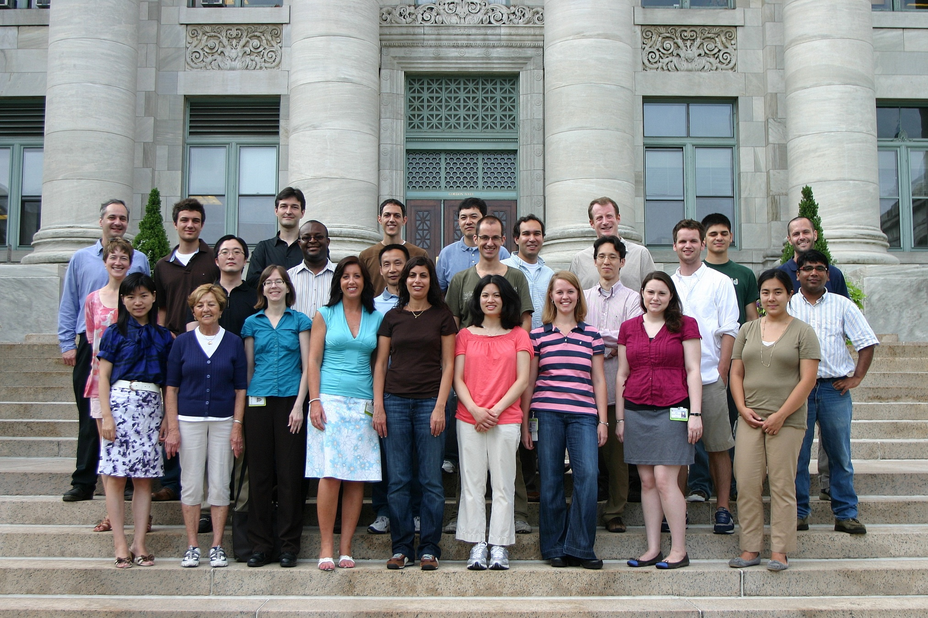
Acknowledgements: The Meyerson Laboratory

