Slide 1

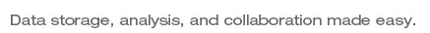
BaseSpaceR
Adrian Alexa aalexa@illumina.com

Slide 2
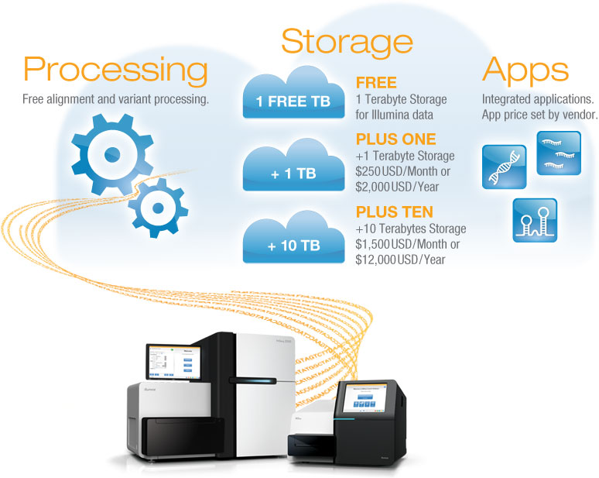

BaseSpace - Plug and Play Genomic Cloud Solution
From Sample to Biological Insight
Seamless Instrument Integration
Harness the Internet
Accessible to Everyone
Data transferred as the instrument runs
Data available in BaseSpace within minutes of a run finishing
Automatic de-multiplexing and FASTQ generation
Notes:
Is the user paying for both the app and the data transfer?

Slide 3
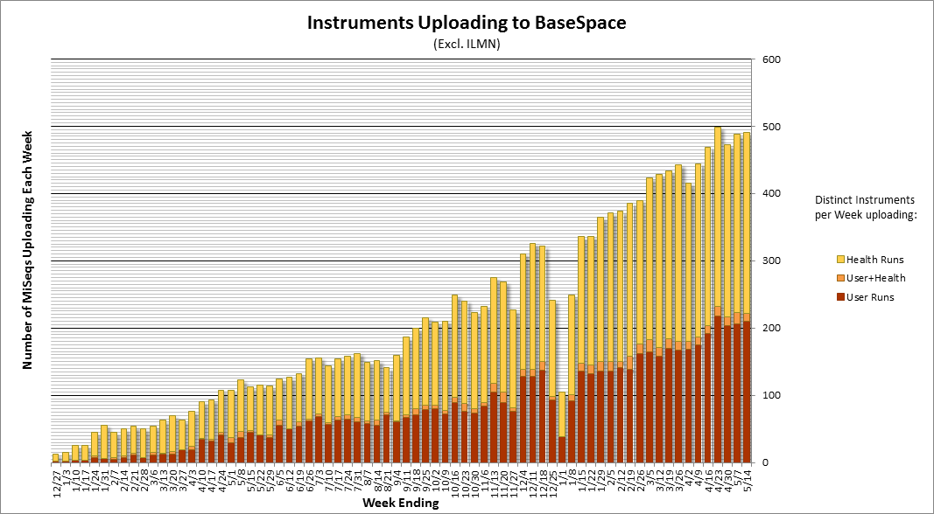
BaseSpace
Data storage, analysis and collaboration.
Almost 40,000 Instrument Runs Streamed to BaseSpace by April 2013
Notes:
Ask Mayank what the different bars represent!
Would also be good to redo the picture (we can get a nicer one in R) if the data is still there.

Slide 4
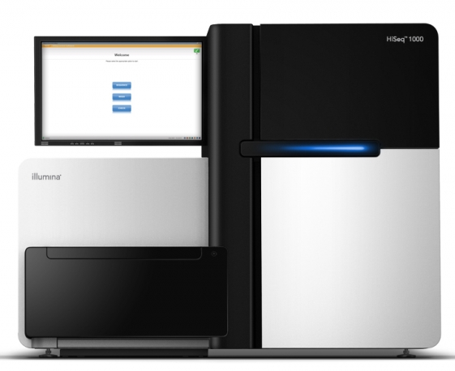

BaseSpace API
REST API and Native Apps
Users
App
App
App
App
App
App
Dev
Portal
SaaS
UI
Developers
PaaS
BaseSpace API
OpenStack
Instruments
IaaS
Visualization
Secondary Analysis
Validation
Biological Inference
Methods Development
Notes:
Mention about Native Apps!

Slide 5
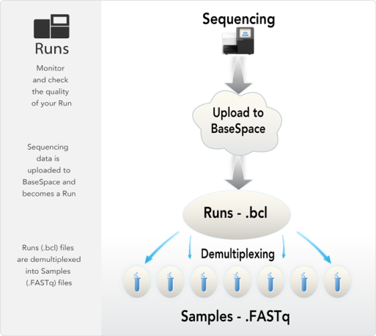
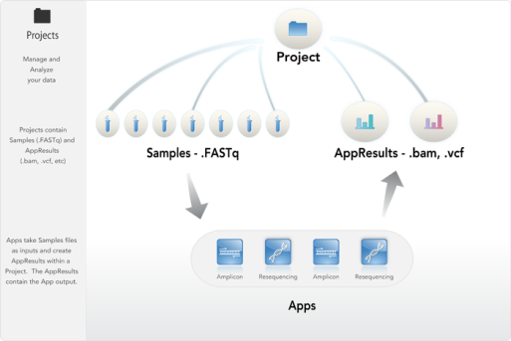
BaseSpace API
Data Model

Slide 6



BaseSpaceR = BaseSpace + R + Bioconductor
A translation layer between BaseSpace’ REST API and R data structures
Cloud based content management system, facilitating the storage and sharing of genomic data.
Rich environment of statistical and data analysis tools for high-throughput genomic data.
Persistent connection with the REST server and support for the REST API query parameters.
Vectorized operations in line with the R semantic. Allows for queries across multiple Projects, Samples, AppResults, Files, etc.
S4 class system used to represent the BaseSpace data model.
Integration with Bioconductor libraries and data containers [working on it…].
Portability on most platforms: Linux, Windows and Mac OS X.
Features
Notes:
What I want to emphasis here is that BaseSapceR leverages
All the data and metadata offered by BaseSpace and the cloud infrastructure – parallelism
The computational tools offered by R and Bioconductor

Slide 7
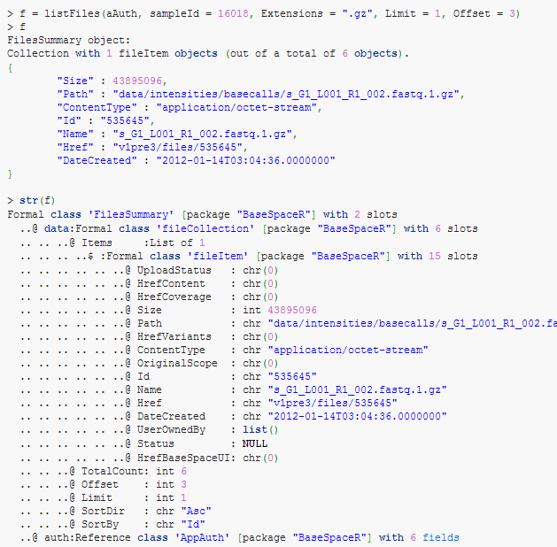
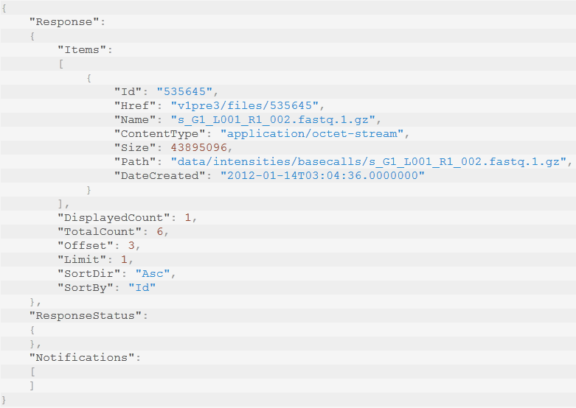
BaseSpaceR
REST API and R data structures
REST API
R API
GET https://api.basespace.illumina.com/v1pre3/samples/16018/files?Extensions=gz&Offset=3&Limit=1

Slide 8
Q-score distribution
Access to the FASTQ files
Authentication [3 lines of code]
  User needs to interact with the BaseSpace UI (or via a web server).
> aAuth <- AppAuth(client_id = "5b123858536b473ba740e9a9eb0abf64",
+ client_secret = "b3168bf65bf543f3b6e7f087856922df",
+ scope = "CREATE GLOBAL, BROWSE GLOBAL, CREATE PROJECTS")
Launching browser for OAuth authentication...
> requestAccessToken(aAuth)
Access token successfully acquired!
> aAuth
Object of class "AppAuth" with:

Slide 9
Q-score distribution
Access to the FASTQ files
Authentication [3 lines of code]
  User needs to interact with the BaseSpace UI (or via a web server).
Select a sample (collection of FASTQ files) from the Project of your choice [3 lines]
> myProj <- listProjects(aAuth)
> data.frame(Name = Name(myProj), Id = Id(myProj))
Name Id
1 BaseSpaceDemo 2
2 Cancer Sequencing Demo 4
3 HiSeq 2500 7
...............................
> sampl <- listSamples(aAuth, projectId = 2, Limit = 1)
> inSample <- Samples(sampl, simplify = TRUE)
> inSample
#Samples object:

Slide 10
Q-score distribution
Access to the FASTQ files
Authentication [3 lines of code]
  User needs to interact with the BaseSpace UI (or via a web server).
Select a sample (collection of FASTQ files) from the Project of your choice [3 lines]
Download the files (FASTQs in our case) [4 lines]
> f <- listFiles(inSample, Extensions = ".gz")
> idx <- grep("_R(1|2)_", Name(f))
> outDir <- paste("Sample", Id(inSample), sep = "_")
> getFiles(aAuth, id = Id(f)[idx], destDir = outDir, verbose = TRUE)
Downloading 4 files in directory: Sample_16018
Downloading file: data/intensities/basecalls/s_G1_L001_R1_001.fastq.1.gz
........................................................................
> file.exists(file.path(outDir, f$Path[idx]))
[1] TRUE TRUE TRUE TRUE

Slide 11
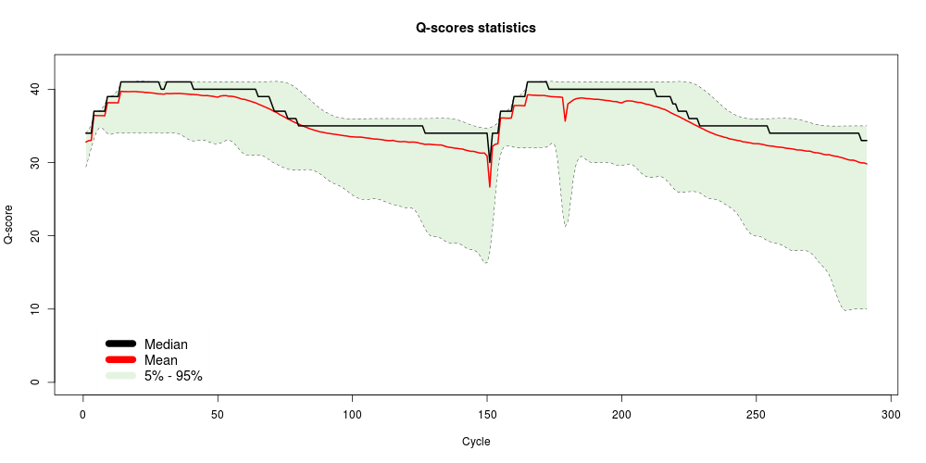
Q-score distribution
Access to the FASTQ files
Authentication [3 lines of code]
  User needs to interact with the BaseSpace UI (or via a web server).
Select a sample (collection of FASTQ files) from the Project of your choice [3 lines]
Download the files (FASTQs in our case) [4 lines]
Process the downloaded files and compute the stats […]
> library(ShortRead)
> source("QscoreApp-functions.R")
> qtab <- lapply(floc, getQscoreCounts)
> idxR1 <- grep("_R1_", names(floc), fixed = TRUE)
> idxR2 <- grep("_R2_", names(floc), fixed = TRUE)
> x <- getQscoreStats(cbind(Reduce("+", qtab[idxR1]), Reduce("+", qtab[idxR2])))
> ylim <- range(x) + c(-2L, 2L)
> plot(x = seq_len(nrow(x)), type = "n", ylim = ylim,
+ xlab = "Cycle", ylab = "Q-score",
+ main = "Q-scores statistics")
> sx <- apply(x[, c("5%", "95%")], 2, function(x) smooth.spline(x)$y)
> sx[, "95%"] <- pmax(sx[, "95%"], x[, "median"])
> polygon(c(1L:nrow(x), nrow(x):1L), c(sx[, "95%"], rev(sx[, "5%"])), col = "#CCEBC580", border = NA)
> matpoints(sx, type = "l", lwd = .5, lty = 2, col = "black")
> lines(x[, "mean"], lwd = 2, col = "red")
> lines(x[, "median"], lwd = 2, col = "black")

Slide 12
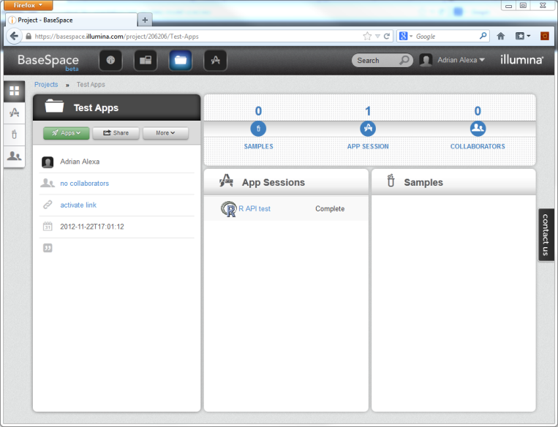
Q-score distribution
Access to the FASTQ files
Authentication [3 lines of code]
  User needs to interact with the BaseSpace UI (or via a web server).
Select a sample (collection of FASTQ files) from the Project of your choice [3 lines]
Download the files (FASTQs in our case) [4 lines]
Process the downloaded files and compute the stats […]
Upload results back to BaseSpace [~10 lines]
  Results are collection of files for now, minimal visualisation.

Slide 13
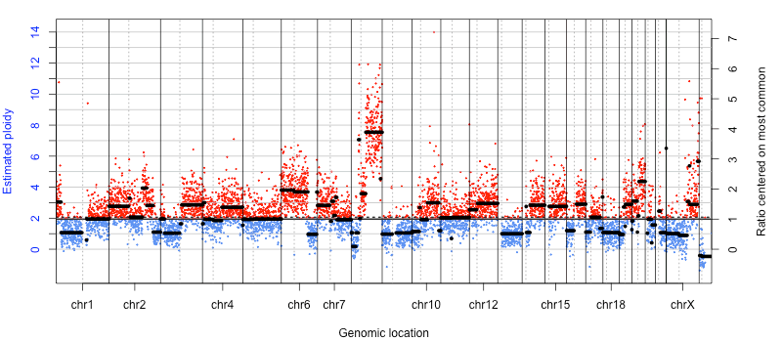
Copy Number Abnormalities
Accessing the coverage via a high-level REST method
Detect amplifications and deletions in cancer samples
Data can be obtained from a single MiSeq runs (one for tumor and one for normal or even both on a flowcel).
Typical analysis requires only the coverage data and this can be directly obtained using a REST method.
Corrects for tumor ploidy and purity.
Location of centromeres indicated by vertical dotted lines
Amplification of distal chr8q.
Homozygous deletion of part of chr8p.

Slide 14
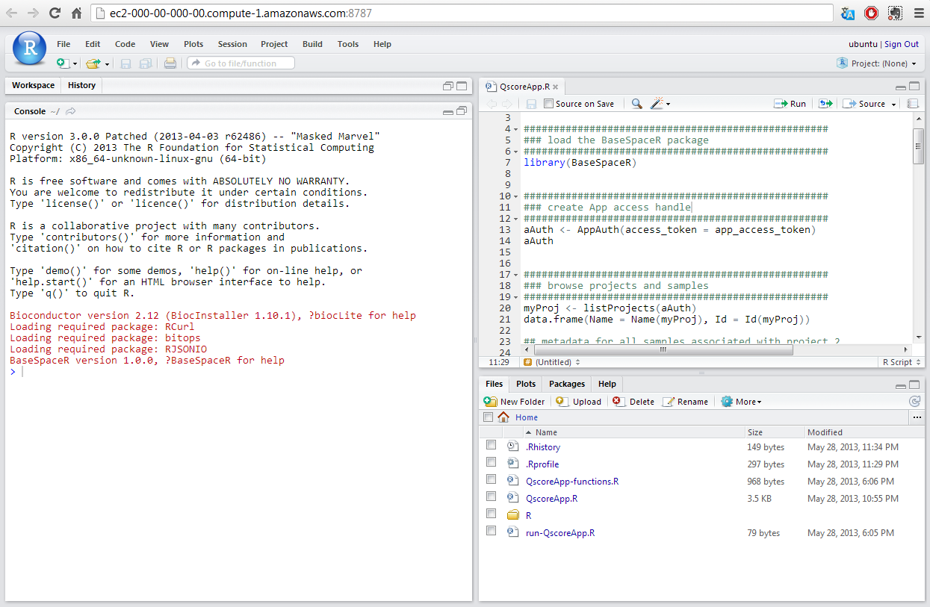
RConsole
Exploring BaseSpace data using RStudio

Slide 15
What’s next
Facilitate the use of Bioconductor packages – there is much to gain if as many Bioconductor packages as possible can consume data (directly) from BaseSpace.
Introduce high-level methods (REST or R API) for random access to BAMs, VCFs, metric data, etc. One can already use Rsamtools for indexed BAMs.
R level methods to facilitate RNAseq, ChipSeq, etc. analyses.
BaseSpace Data Central – publicly available data – most of it will be data coming from our latest instruments, chemistry, workflows.

Slide 16
Resources
Tutorials, videos, whitepapers and other educational material:
  http://www.illumina.com/software/basespace/basespace-education.ilmn
BaseSpace homepage:
  https://basespace.illumina.com
BaseSpace developer portal:
  https://developer.basespace.illumina.com
Bio-IT World Asia presentation:
  https://dl.dropboxusercontent.com/u/14162259/BioITAsia_MJJ.pptx
More documentation on BaseSpace:
  http://support.illumina.com/sequencing/sequencing_software/basespace/documentation.ilmn
BaseSpaceR homepage on Bioconductor:
  http://bioconductor.org/packages/release/bioc/html/BaseSpaceR.html

